Slide 1
40 Years of MAARC With MAARC’s past presidents
14 June 2024

Slide 2
MAARC’s Past Presidents
Joe Koester (1984-1992)
Lloyd Kendall (1992-1994)
Sam Cannan (1994-1996)
Ed Lyon (1996-2001)
Geoff Shearer (2001-2010)
Steve Hansman (2010-2012)
Eric Stenberg (2012-2017)
John Begg (2017-Present)

Slide 3
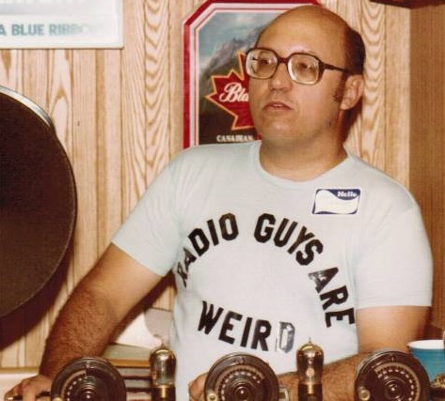
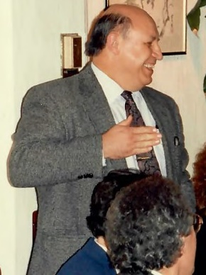
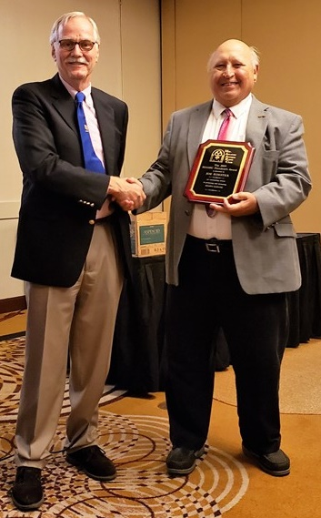
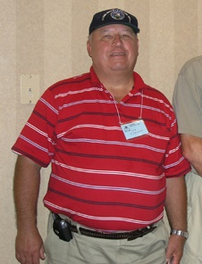
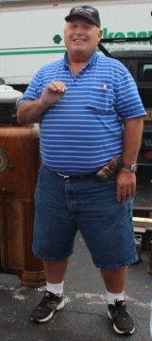
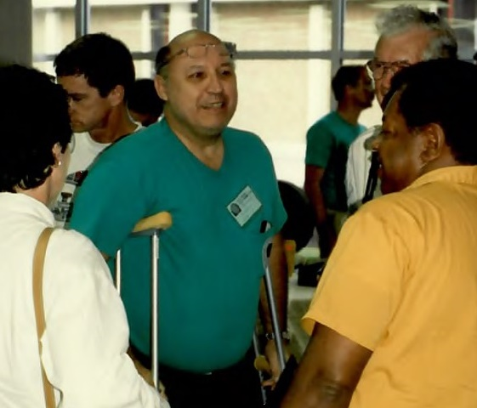
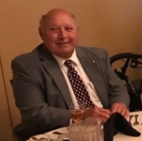
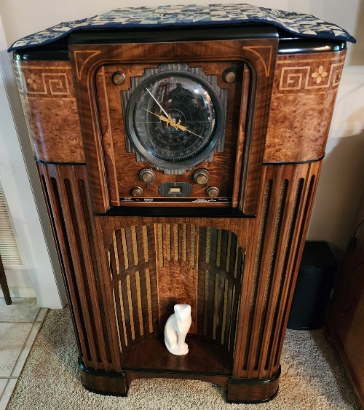
Joe Koester (1984-1992)
Notes:
What were you doing occupation wise at the time you were president?
What are you doing now?
What is the most prized item in your collection?

Slide 4
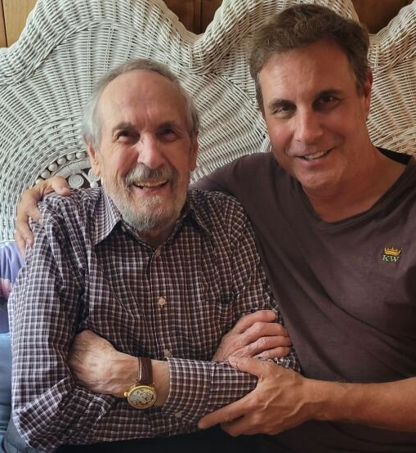
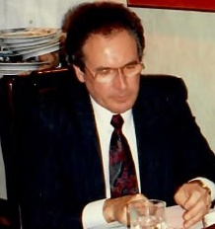
Lloyd Kendall (1992-1994)
Notes:
When I asked him How did you initially find out about the club, he told me this:
When I asked him what he was doing occupation wise at the time he was the MAARC president, Lloyd stated he was the Vice President of a technology company. He has been retired for the last 11 years.
The most prized item in his collection is a spark gap transmitter that was built by former MAARC member Mel Comer.

Slide 5
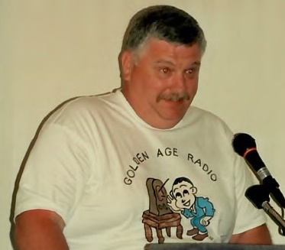
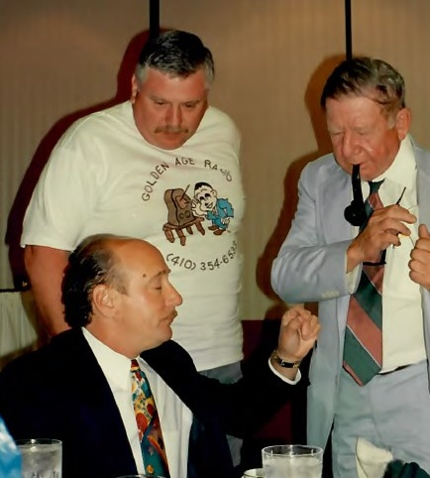
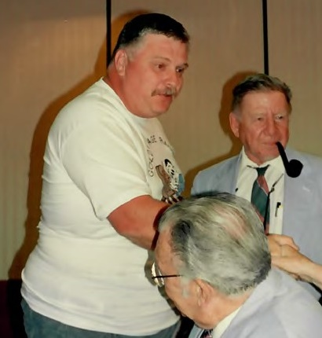
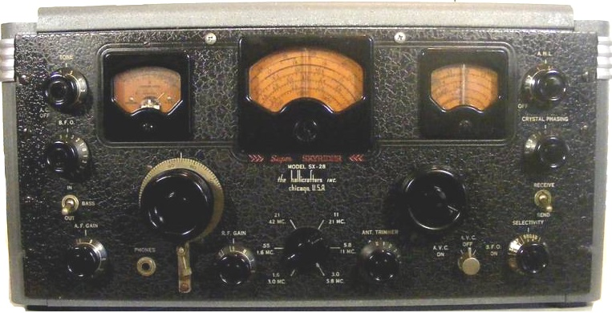
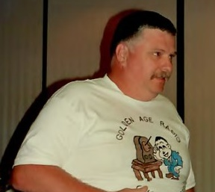
Sam Cannan (1994-1996)
Notes:
How did you initially find out about the club?
When did you join?
What were you doing occupation wise at the time you were president?
What are you doing now?
What is the most prized item in your collection?
Tell us a bit more about Golden Age Radio.

Slide 6
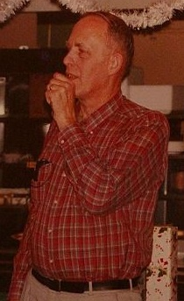
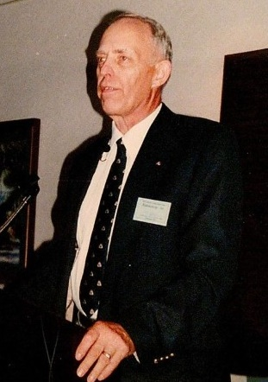
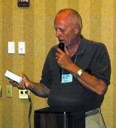
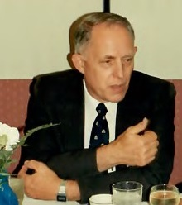
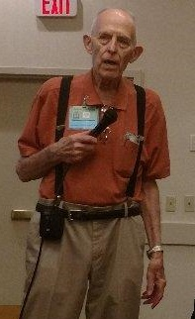
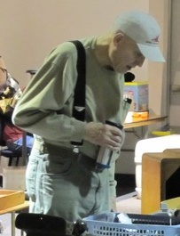
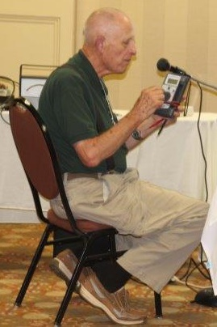
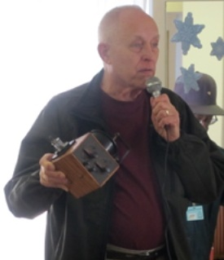
Ed Lyon (1996-2001)
Notes:
How did you initially find out about the club?
When did you join?
What were you doing occupation wise at the time you were president?
What are you doing now?
What is the most prized item in your collection?

Slide 7
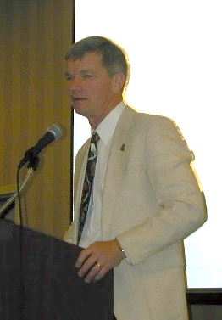
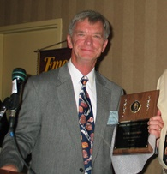
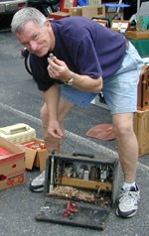
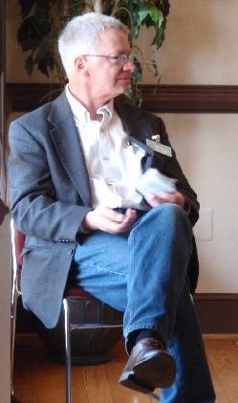
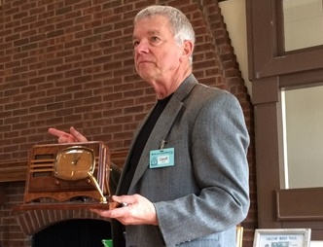
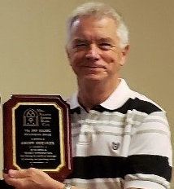
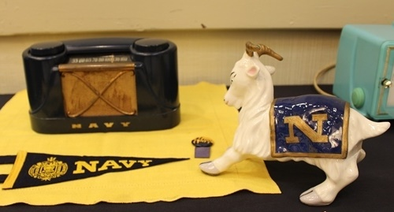
Geoff Shearer(2001-2010)
Notes:
How did you initially find out about the club?
When did you join?
What were you doing occupation wise at the time you were president?
What are you doing now?

Slide 8
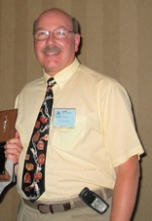
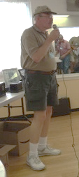
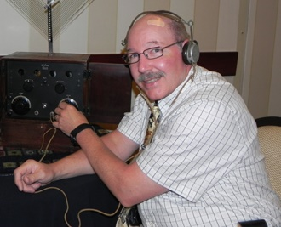
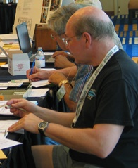
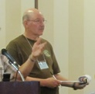
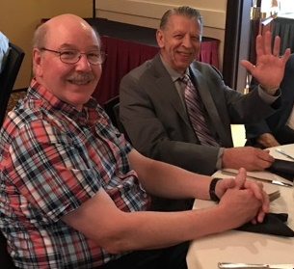
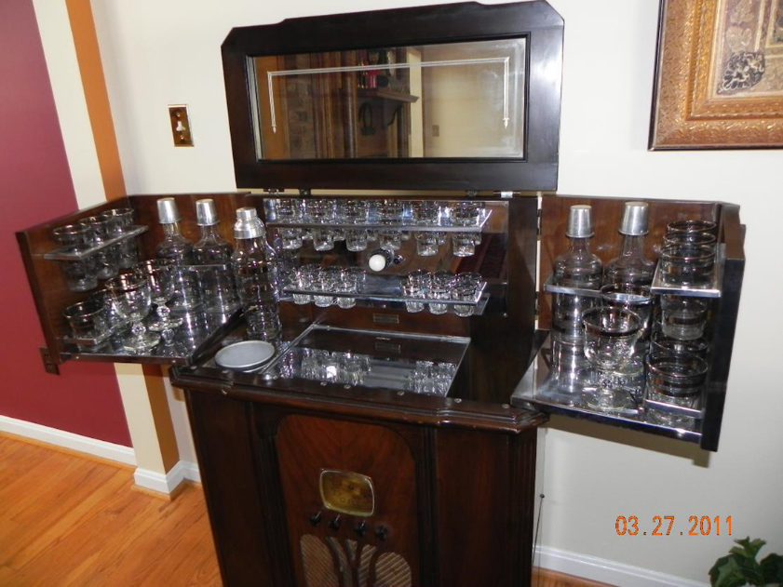
Steve Hansman (2010-2012)
Notes:
How did you initially find out about the club?
When did you join?
What were you doing occupation wise at the time you were president?
What are you doing now?
What is the most prized item in your collection?

Slide 9
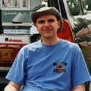
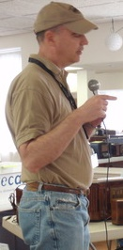
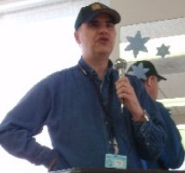
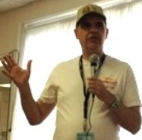
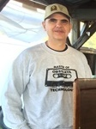
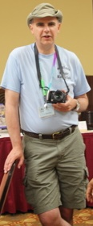
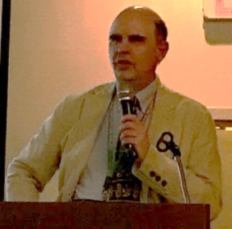
Eric Stenberg (2012-2017)
Notes:
How did you initially find out about the club?
When did you join?
What were you doing occupation wise at the time you were president?
What are you doing now?
What is the most prized item in your collection?

Slide 10
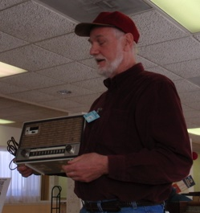
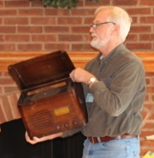
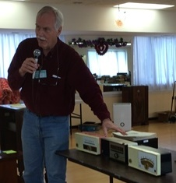
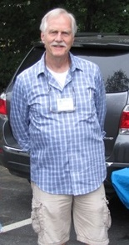
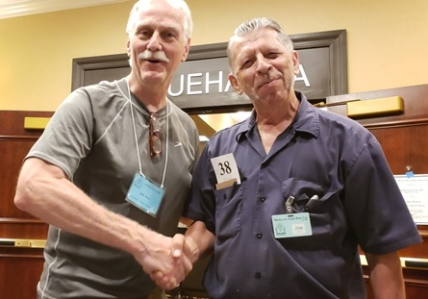
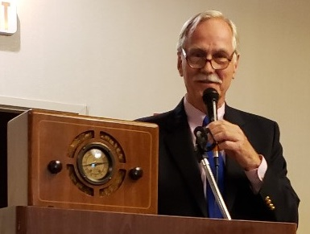
John Begg (2017-Present)
Notes:
How did you initially find out about the club?
When did you join?
What were you doing occupation wise at the time you were president?
What are you doing now?
What is the most prized item in your collection?

Slide 11
In The Beginning…
Notes:
Joe, briefly tell us about how MAARC got started.

Slide 12
The MAARC Picnics / Fallfest
Notes:
Ed, tell us about those Grand Picnics at your Farm, and how they ended up morphing to our current day Fallfest activities.

Slide 13
RadioActivity
Notes:
Ed, tell us about how the name RadioActivity came to being.
Joe, tell us out the two events we had in 1987 and 1991 that preceded our own RadioActivity event.
Sam, tell us about the early MAARC RadioActivity events.

Slide 14
Key Club Highlights – RadioActivity 2011
Notes:
Steve, tell us about the DeForest themed RadioActivity event in 2011.

Slide 15
Key Club Highlights – RadioWinterFest ‘14
Notes:
Eric, tell us how RadioWinterfest came to light.

Slide 16
Key Club Highlights – RadioActivity 2006
Notes:
Geoff, Tell us about this key club highlight.
Lloyd Kendall remembered spending enjoyable hours, both at Joe’s house and at home, responding to letters received from across the nation regarding old radios.
Joe, I believe you also brought that up.
Eric, tell us about Brian Belanger’s Public Radio interview and its results.
John, So far, what has been the club highlight that occurred during your time as president.

Slide 17
Biggest Challenges

Slide 18
Memorable Moments
Notes:
John, Tell us about this memorable moment.
Lloyd Kendall remembered spending enjoyable hours, both at Joe’s house and at home, responding to letters received from across the nation regarding old radios.
Joe, I believe you also brought that up.
Eric, tell us about Brian Belanger’s Public Radio interview and its results.
Geoff, tell us about the decision to purchase the rights to Radio Age.

Slide 19
Members we Miss - Willie Sessoms
Notes:
When I asked Lloyd Kendall ‘what interesting member do you recall who is no longer with us’, he immediately gave me this response:
Geoff, tell us what Willie meant to you.
John, can you add to that?

Slide 20
Members we Miss - Ted Hannah

Slide 21
Members we Miss - Paul Farmer
Notes:
Eric, You knew Paul both professionally and through the club. Tell us a bit about Paul.

Slide 22
Members we Miss - Chris Kocsis
Notes:
Steve, you mentioned Chris. Tell us about him.
Do you remember what he primarily collected?

Slide 23
Members we Miss - Mel Comer
Notes:
Ed, tell us about Mel Comer, his Melodyne radios, and what he meant to you?

Slide 24
Advice for New Members
Notes:
Geoff, what advice would you provide to a new member?
Steve, what suggestions do you have for someone just joining the club?
John, do you have any New Member suggestions?

Slide 25
MAARC’s Future
Notes:
Joe, What do you see for the future of MAARC?
John, as the current club president, do you have anything to add to Joe’s perspective on MAARC’s future?

