Slide 1
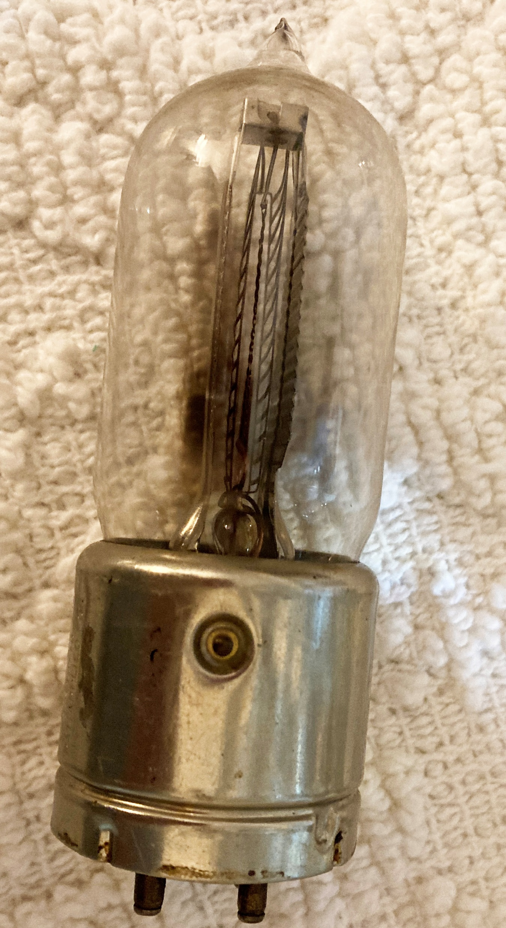
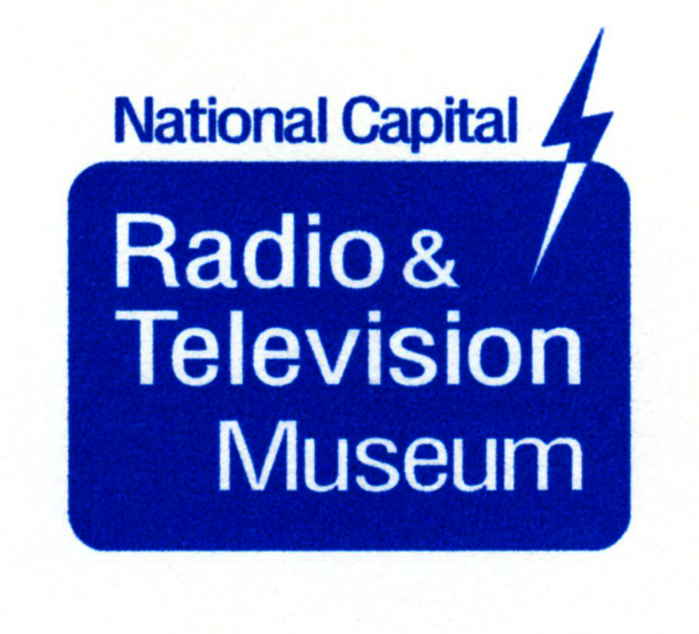
All About Getters: Vacuuming Out Vacuum Tubes
Brian Belanger
Curator, NCRTV Museum

Slide 2
What is a Getter?
Answer: a substance put into a vacuum tube to remove residual gases—to “Get” or trap gas molecules that the evacuation process failed to remove

Slide 3
Getter Materials
Getters are chemically active substances, e.g.,
Magnesium
Calcium
Barium (used in more modern tubes)
Strontium
Phosphorus
Aluminum
Lime

Slide 4
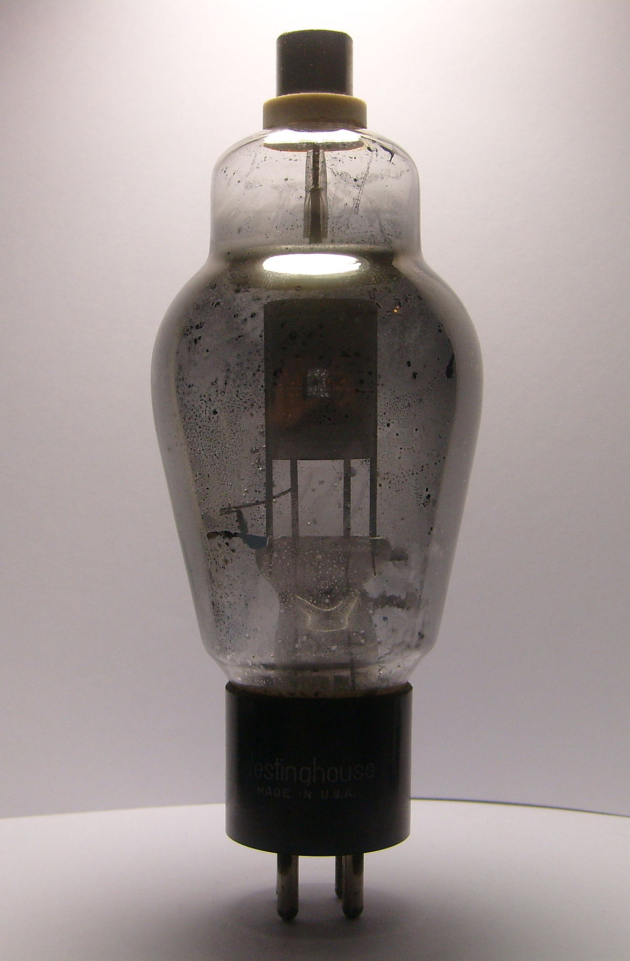
Vacuum vs. Gas in Tubes
Not all radio tubes were evacuated
Tubes like the Tungar bulb rectifiers, early detector tubes like the 00A, and later tubes like the 0Z4 and 0B2 contained gas.
866 and 83 tubes contained mercury vapor

Slide 5
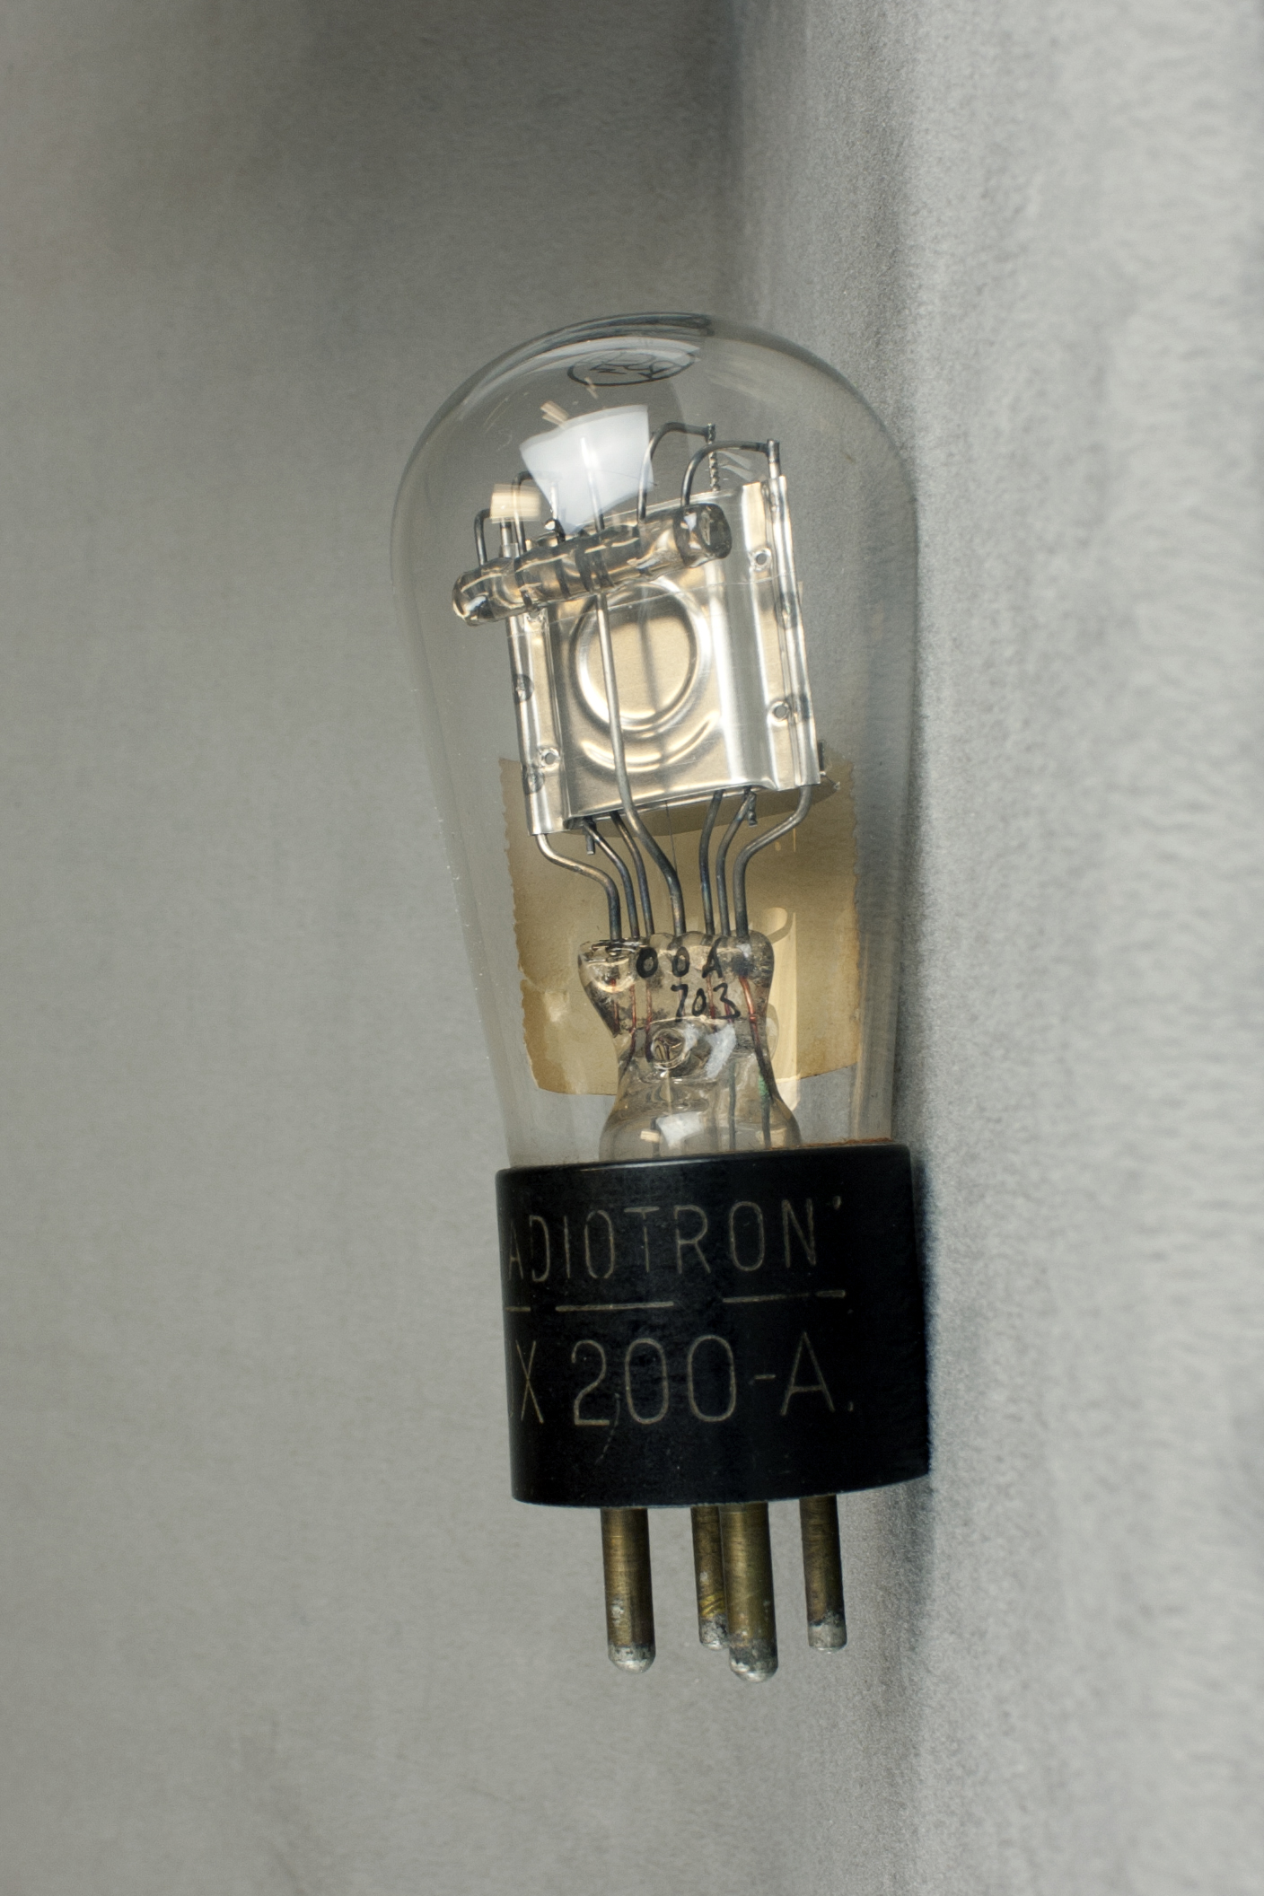
Vacuum vs. Gas in Tubes
The UX-200 used argon gas, the
UX-200A, cesium vapor
Lee de Forest believed that his Audion triode needed residual gas to work properly
GE and Bell Labs showed that most amplifier tubes worked best with a high degree of evacuation

Slide 6
Making a High Vacuum Tube
Before sealing the tube, connect it to a vacuum pump and pump out as much air as you can
While pumping, heat the glass and contents as high you can without softening the glass to remove occluded gas molecules (typical bakeout temperatures: 300 to 500 C)
Use RF induction heating to heat the metal parts even hotter and flash the getter

Slide 7
Some Residual Gases Are Worse Than Others
Oxygen is very bad – oxidizes the cathode and reduces electron emission
Even inert gases are bad because they can create ions which can neutralize the space charge and sputter material off the cathode
It is hard to find a getter that works equally well for all gas molecules

Slide 8
Pumping Out Was Difficult Initially
Early vacuum pumps performed poorly
Vacuum gauges were inaccurate, so it was hard to know what level of vacuum had been achieved
Glass to metal seals were poor, so slow leaks were not uncommon

Slide 9
Not Easy to Find Information About Getters
Gettering was a proprietary technology
Companies did not talk about trade secrets, and sometimes did not file gettering patents so as not to tip off competitors about what had been found to work

Slide 10
Early Tubes
Early tubes apparently did not use getters:
Fleming’s diode valve (he specified the highest possible vacuum)
De Forest’s triode Audion (it had residual gas)
Western Electric VT-1
Prior to WW I, people were only beginning to understand the physics of tubes!

Slide 11
When Were Getters First Used?
Gerald Tyne says some GE tubes as early as 1917-18 had getters, but GE was more sophisticated than most companies
A tube designed by H. J. Round in England circa 1914 had a pellet of asbestos in its tip that could be heated with a match to modify the degree of vacuum--presumably to increase gas
Getters were uncommon until GE introduced the thoriated tungsten filament around 1921 because it was more adversely affected by residual gas than previous filaments

Slide 12
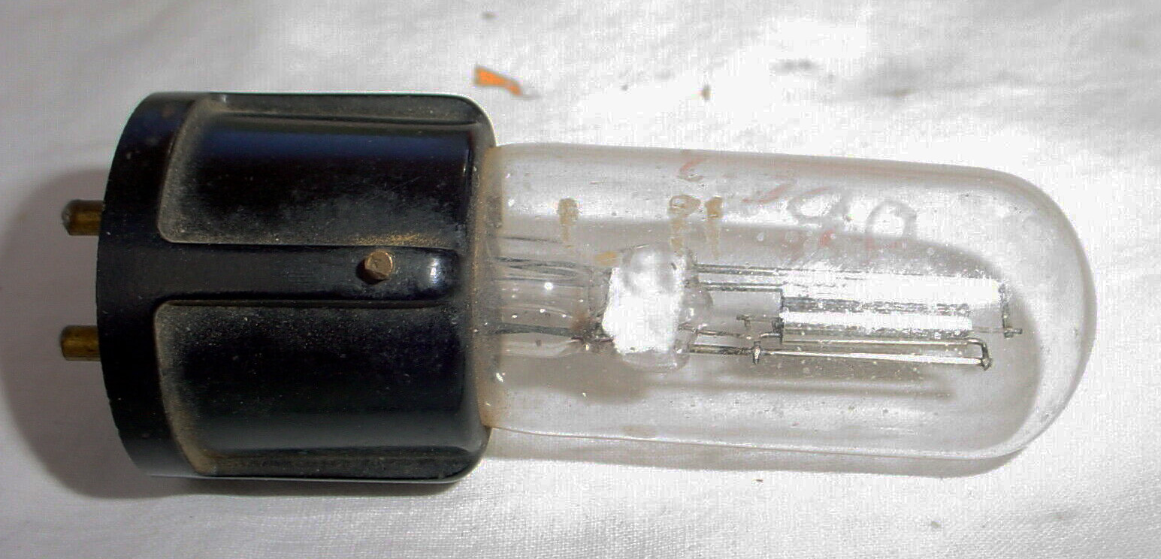
Lime Getters
The earliest Westinghouse tubes did NOT use getters, but later WD-11 and WD-12 tubes did

Slide 13
Phosphorus Getters
GE tubes made at the Nela Park Plant near Cleveland used red phosphorus getters in the early 1920s

Slide 14
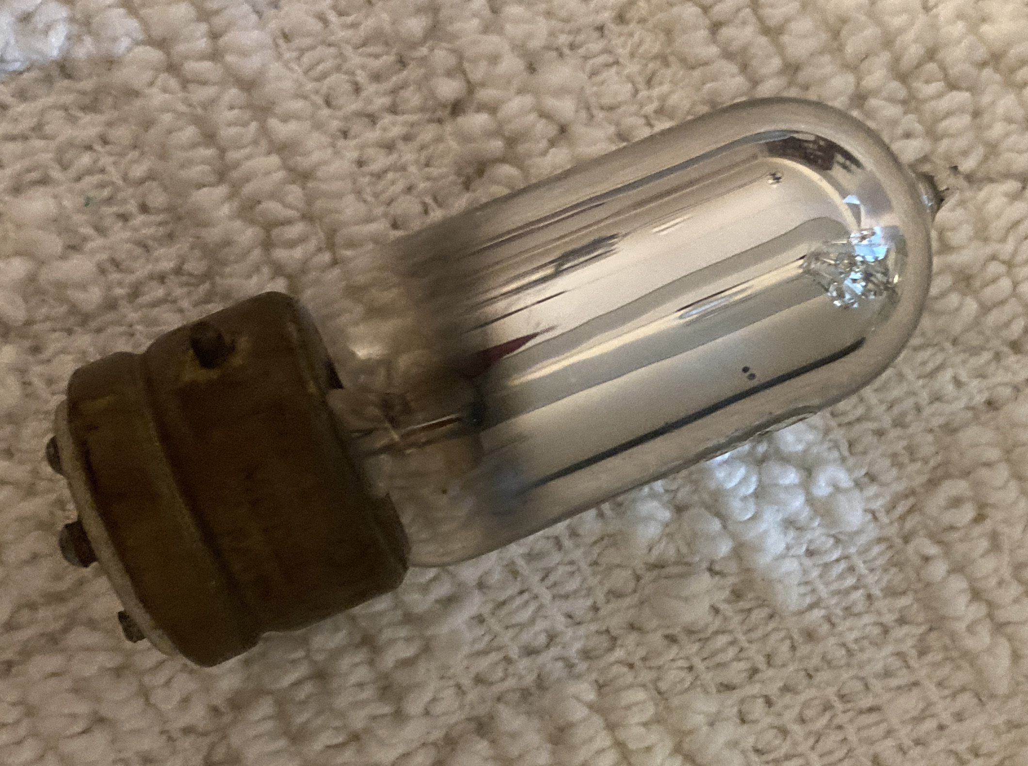
Magnesium Getters
GE tubes made at the Harrison, NJ factory used magnesium getters

Slide 15
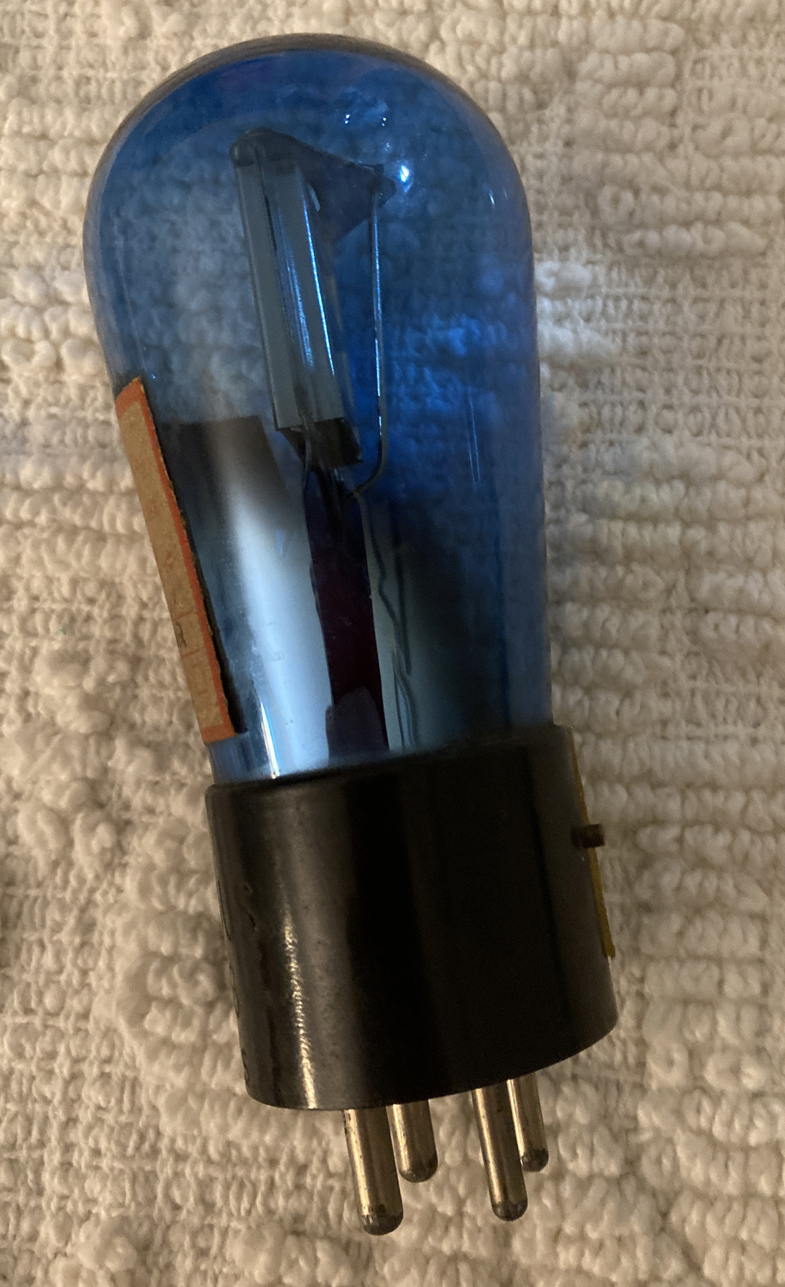
Color NOT Due to a Getter
Arcturus and Brightson blue glass tubes

Slide 16
“Hard” vs. “Soft” Tubes
01A amplifier tubes were “hard” tubes (high vacuum)
00A detector tubes were “soft” tubes (with gas)

Slide 17
Getters vs. Keepers
Getters remove most residual gas during manufacturing
Most getters continue to absorb gas molecules released during the life of the tube (“keepers”)

Slide 18
Flashing the Getter
Lime getters are applied just before evacuating and sealing
Magnesium, phosphorus, and barium getters are flashed (vaporized by rapid heating) at the end of evacuation
Some magnesium getters covered almost the entire glass envelope, others just a small area
Youtube video of getter flashing:
https://www.youtube.com/watch?v=DHreikPrRdU

Slide 19
Getter Placement
In receiving tubes: attached to the anode (plate)
In transmitting tubes: often a separately heated electrode
Placement must be adjusted so the deposited getter material does not cause short circuits between elements
In transmitting tubes, too much getter on the glass causes heat to be reflected back into the tube

Slide 20
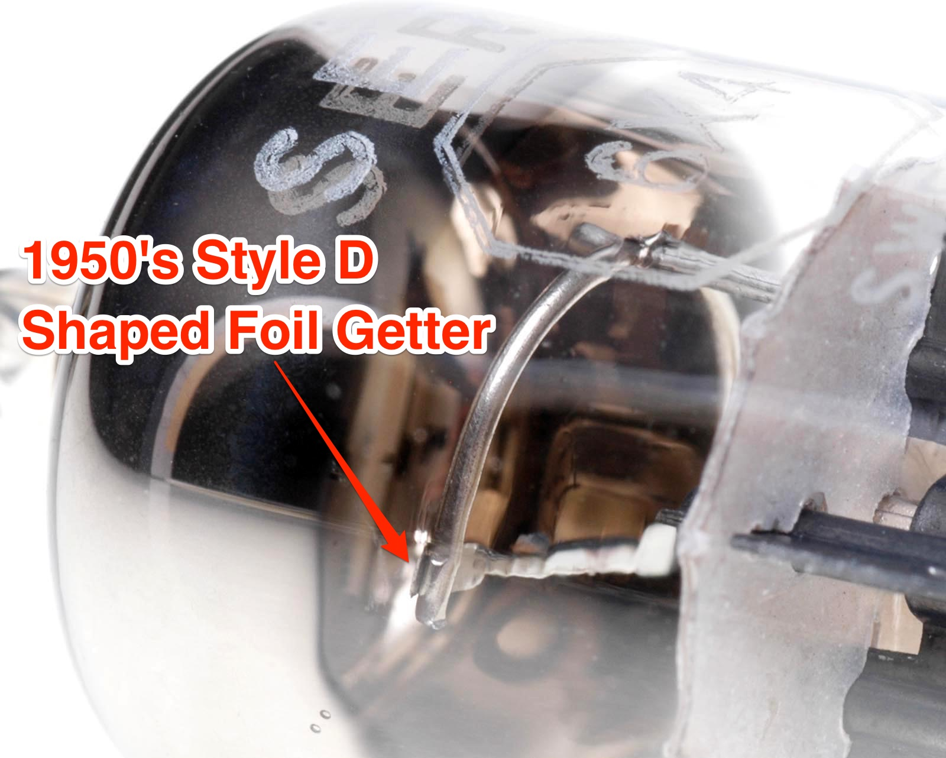
Getter styles
D-shape
Halo shape
A-frame

Slide 21
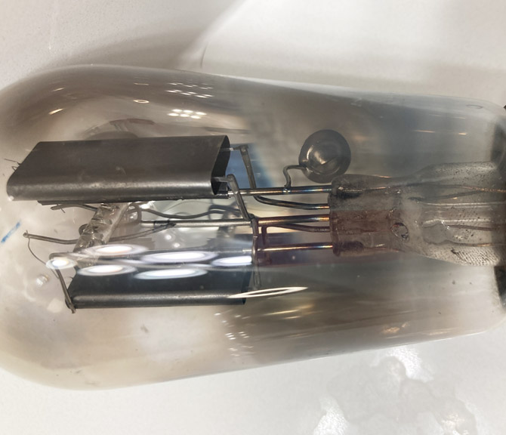
Type 80 Rectifier
Getter

Slide 22
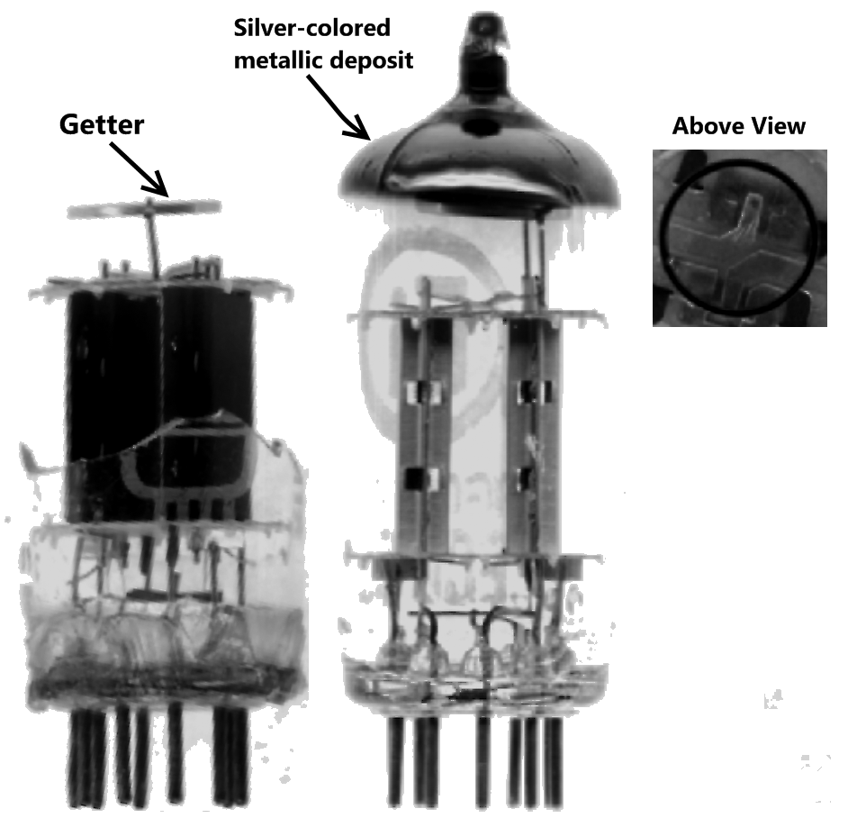
Miniature tube halo getter
For Induction heating, an external coil has many turns. The getter acts like a one-turn secondary that gets very hot.

Slide 23
Glass Vs. Metal Tubes
Glass tubes: Induction heating used to flash the getter
Metal tubes: weld a tantalum or nickel ribbon trough between the metal envelope and the ground pin. Fill the trough with barium berylliate or barium azide. After sealing, send a high current through the trough causing the barium to react with the tantalum to form free barium.

Slide 24
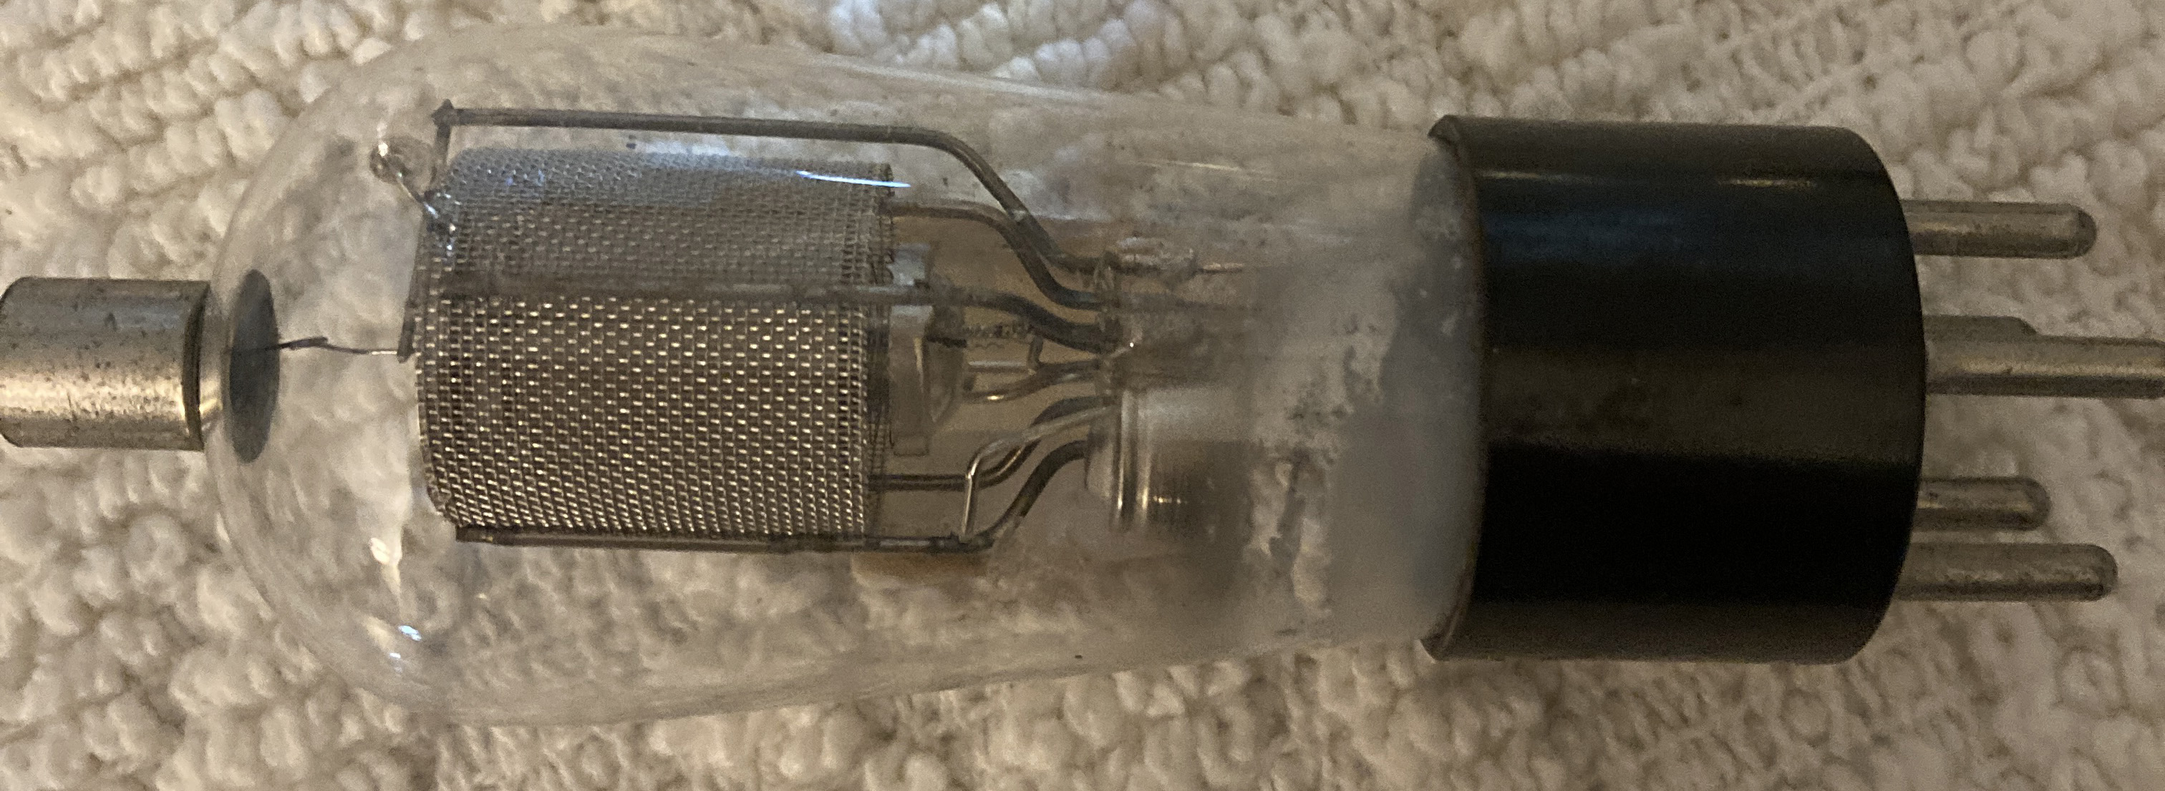
Tubes With Air Leakage
A tube with white powder on the glass probably has had air leak into it

Slide 25
Questions?

