Slide 1
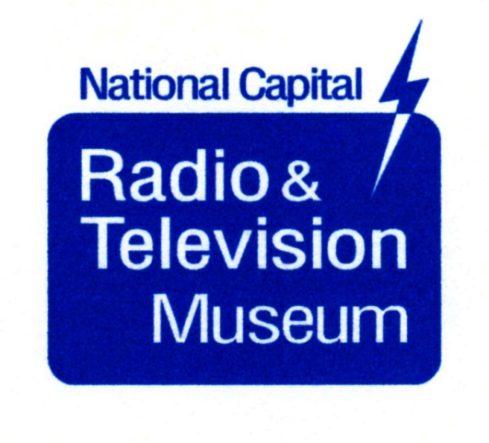
Conelrad (CONtrol of Electromagnetic RADiation)
Those Little Triangles on 1950s Radio Dials
By Brian Belanger, Curator
bbelanger@ncrtv.org

Slide 2
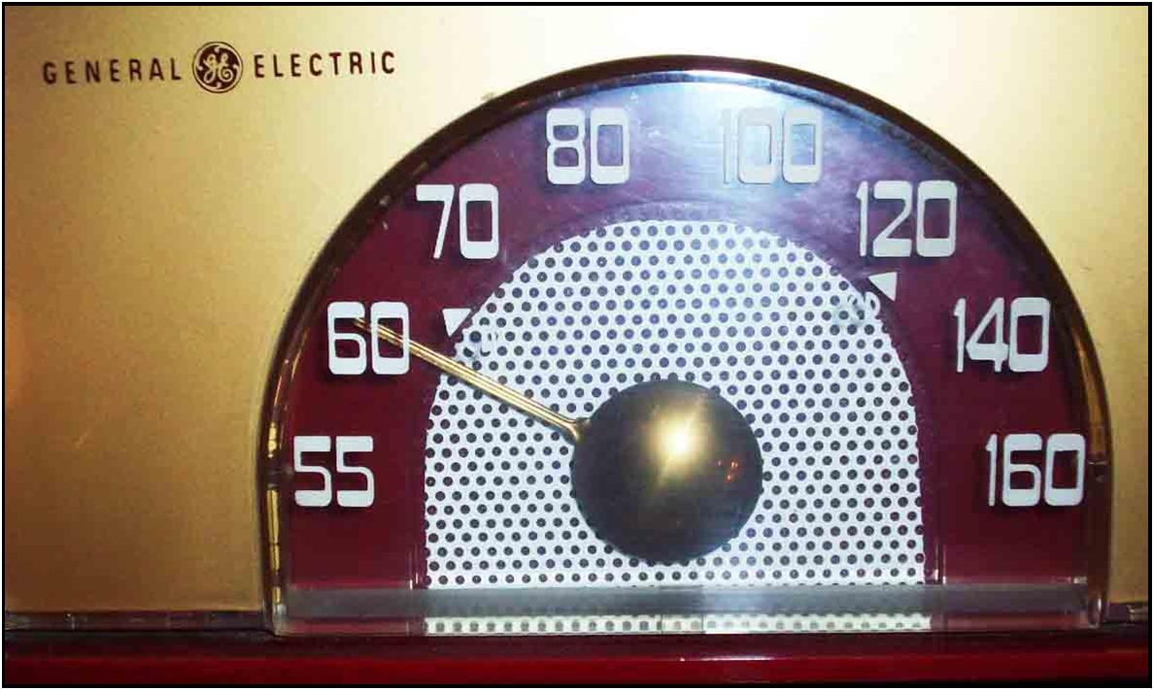
Conelrad 640/1240 triangles on a 1950s GE radio.

Slide 3
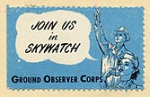
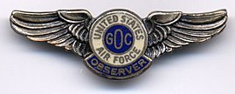
The Ground Observer Corps
During WW II, 1.5 million civilian volunteers watched for German or Japanese airplanes with binoculars
The second GOC was organized in 1950 to watch for Russian bombers

Slide 4
The motivation for CONELRAD:
Cold War era fear of nuclear war
Low-altitude Russian bombers could attack from across the North Pole and come in under the radar screen. The enemy could home in on broadcast stations using direction finding equipment

Slide 5
The motivation for CONELRAD:
When a Russian attack is launched, we must turn off radio and TV transmitters!

Slide 6
CONELRAD
Announced by President Truman in 1951
In a wartime emergency, broadcast stations had to leave the air
Designated emergency broadcast stations (Key Stations) would provide civil defense advice on 640 and 1240 kHz.

Slide 7
CONELRAD
The key stations would take turns broadcasting, so DF could not be used
Telephone lines would be used to coordinate key stations

Slide 8
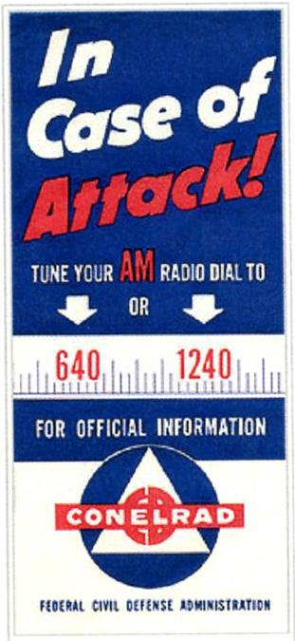
A nationwide advertising campaign (print and broadcast) was launched to make people aware of CONELRAD

Slide 9
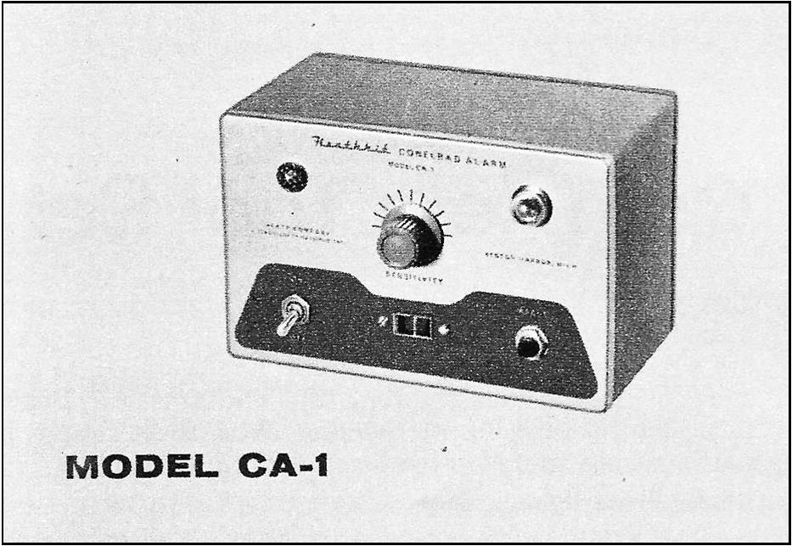
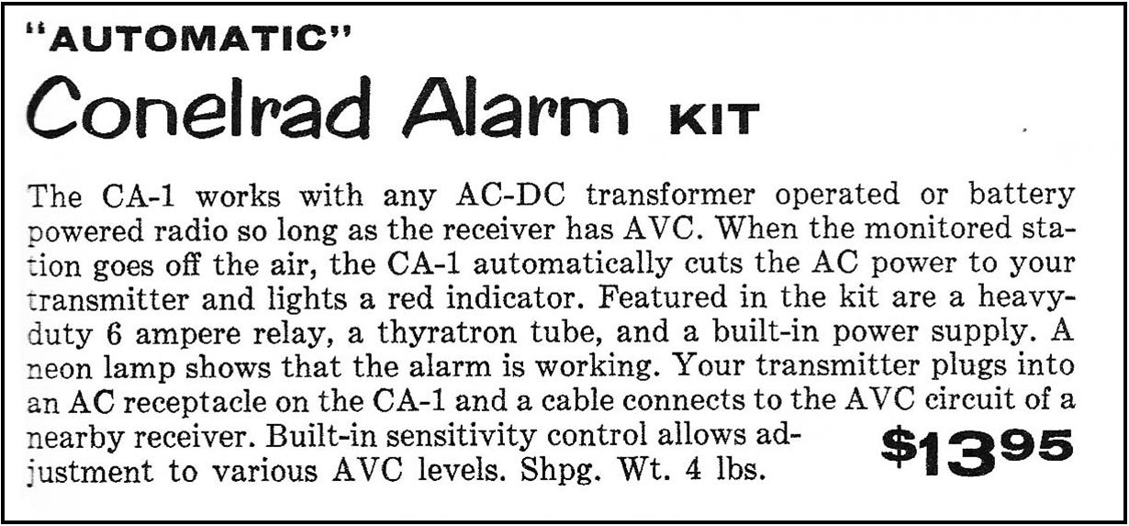
Amateur Radio
Beginning in 1957 ham operators were also required to leave the air in a Conelrad emergency
Some purchased Heathkit Conelrad alarm kits
Some left an AM radio playing in the background
Some ignored the regulation

Slide 10
The DC region and WTOP’s role
Granville Klink’s WTOP scrapbooks at the NCRTV Museum provide insight
WTOP was involved in developing plans and hardware for CONELRAD stations and was a key distribution point for tests and emergency messages

Slide 11
The DC region and WTOP’s role
Five 640 kHz stations and five 1240 kHz stations were selected
Random switching at ~ 2-minute intervals via telephone lines had been intended, but was never implemented

Slide 12
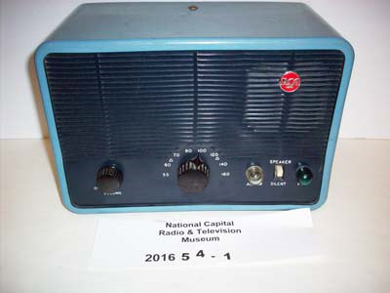
RCA MI-3187B CONELRAD Rcvr.

Slide 13
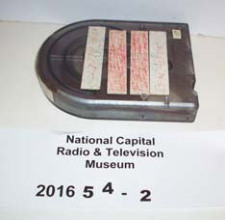
CONELRAD Cassette tape

Slide 14
Why did Conelrad end?
Precision guided ICBMs in the 1960s made bombers with direction finding obsolete! Broadcast stations no longer needed to shut down during an attack.
But civilians still needed to be informed about what to do in an emergency.
In the 1960s a new emergency broadcasting system was developed.

Slide 15
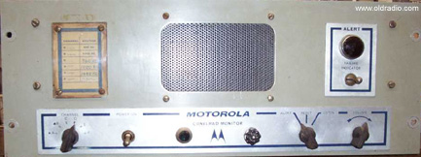
The Emergency Broadcasting System
EBS stations authorized to broadcast emergency information were called Common Program Control Stations (CPC stations)
Stations had to have an EBS receiver. If a 20 second burst of audio tones (853 and 960 Hz) was received, an alarm would go off. Non-CPC stations had to monitor a CPC station.
Motorola DS-9660B CONELRAD receiver

Slide 16
False Alarms (1955, 1959, 1971)
1950s – false alarms quickly corrected
1971 NORAD HQ broadcast the wrong tape in a routine EBS test
Since it occurred at the regularly scheduled test time, most stations assumed it was a false alarm

Slide 17
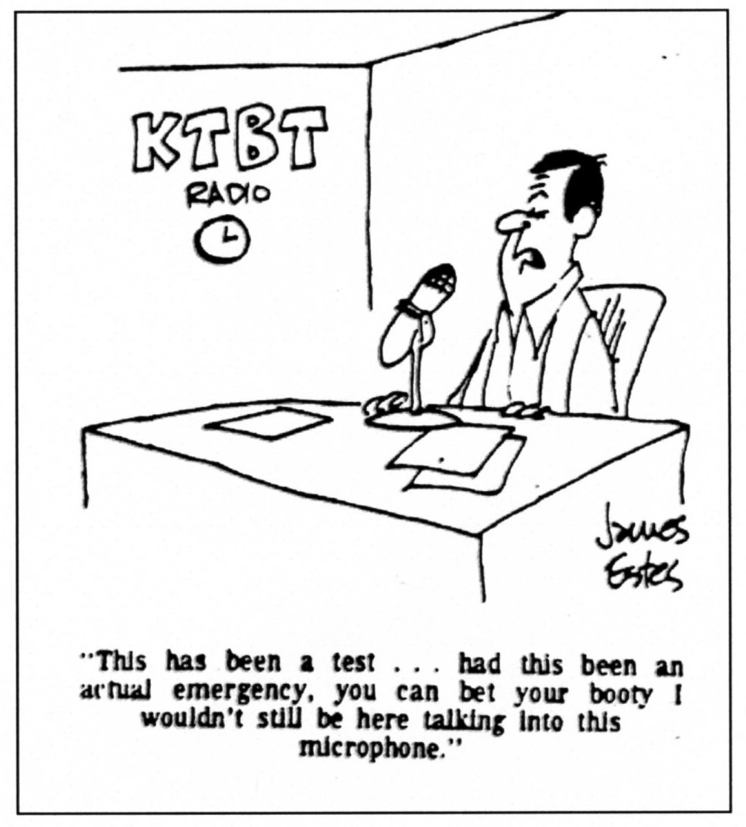

Slide 18
What do we have today?
EBS has evolved and has been upgraded
A revised Emergency Alert System began in 2012
Today FEMA is in charge of emergency alerts to civilians
Radio stations today broadcast NWS tornado warnings

Slide 19
If you see a radio with triangles at 640 and 1240, you know it was from the 1950s!

Slide 20
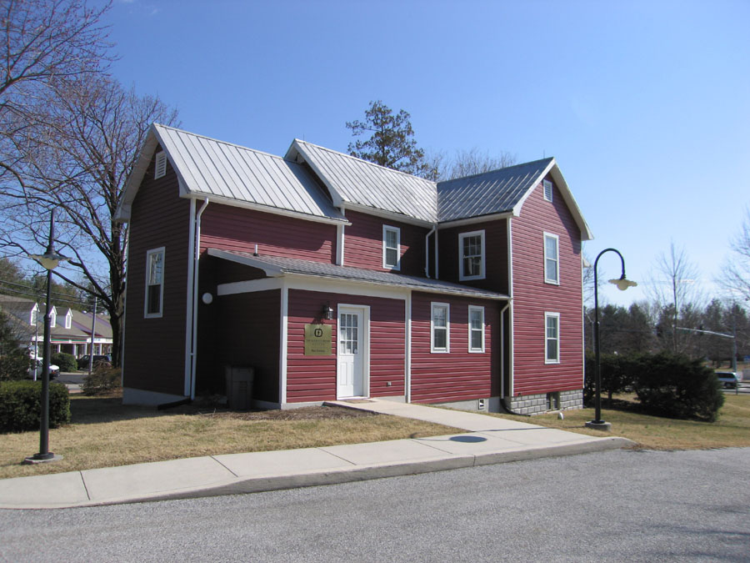
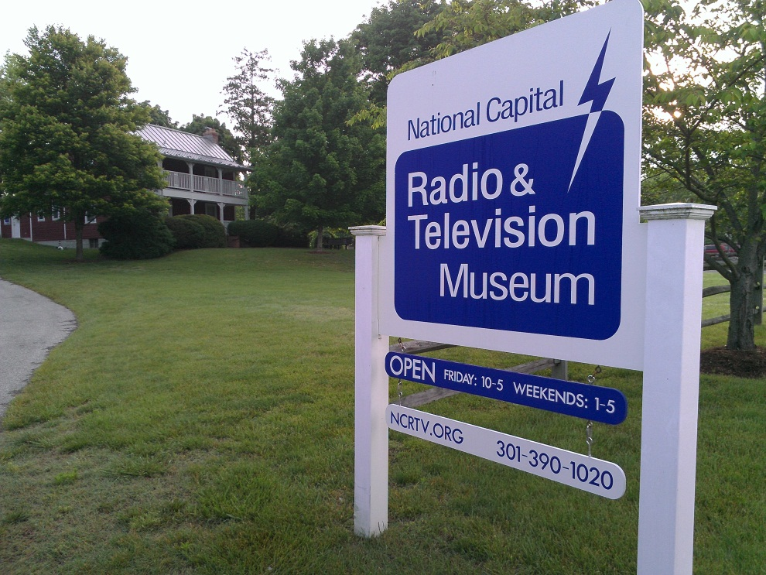
The National Capital Radio & Television Museum
2608 Mitchellville Road
Bowie, MD 20716
301-390-1020 ncrtv.org info@ncrtv.org

Slide 21
About the Museum
Founded by the Mid-Atlantic Antique Radio Club
Opened in June 1999
Free parking, modest admission charge
Visitors from all 50 states and 30 foreign countries
Research library - thousands of books and magazines (offsite)
Restoration shop
Open Fridays 9 to 4, Saturdays and Sundays
from noon to 4

Slide 22
Become a Member!
$25 per year (tax deductible if you itemize deductions)
Benefits:
Quarterly journal – Dials and Channels
Invitations to special events
Discounts on museum shop purchases
Bi-weekly lectures via Zoom
Artifact of the Week
Help to preserve radio/TV history

