Slide 1
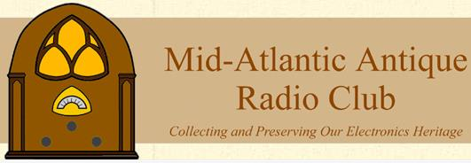
Pioneer Station KDKA's Centennial: 100 Years of Entertainment Broadcasting
Dave Rossetti
03 June 2022

Slide 2
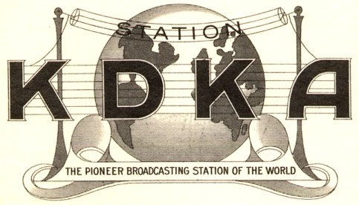

Slide 3
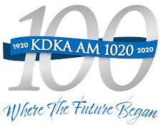

Slide 4
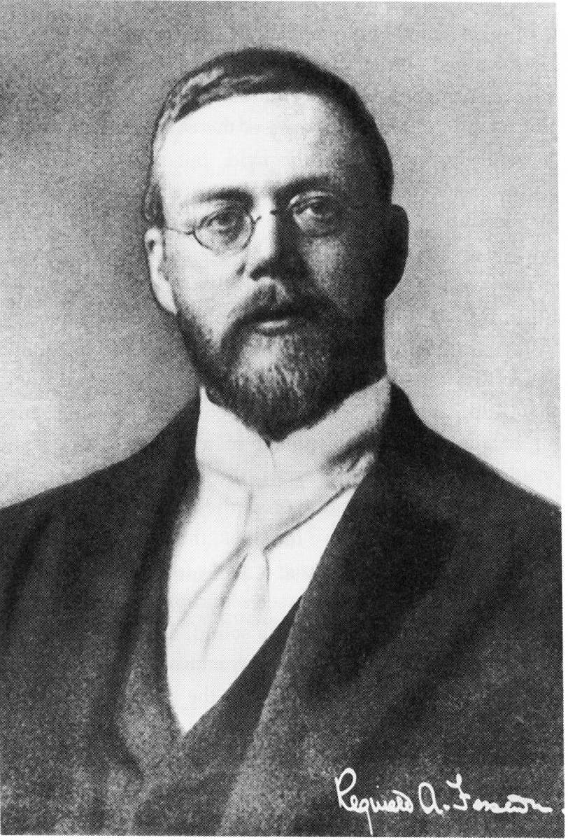
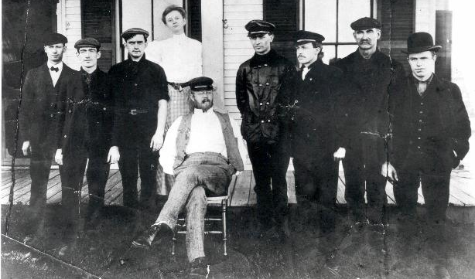
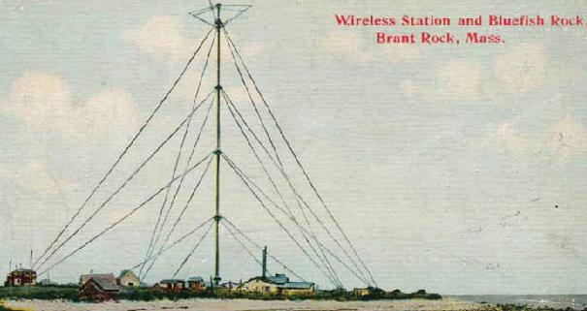
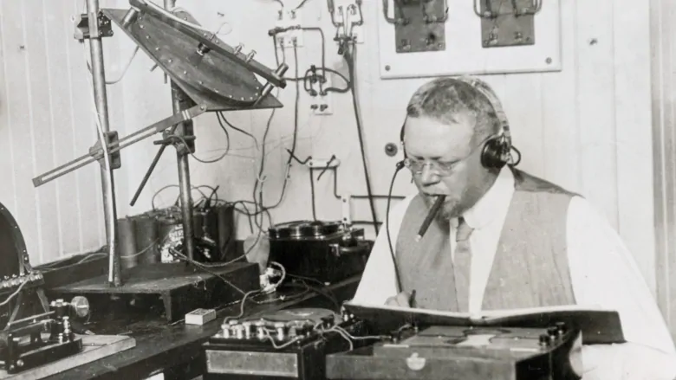
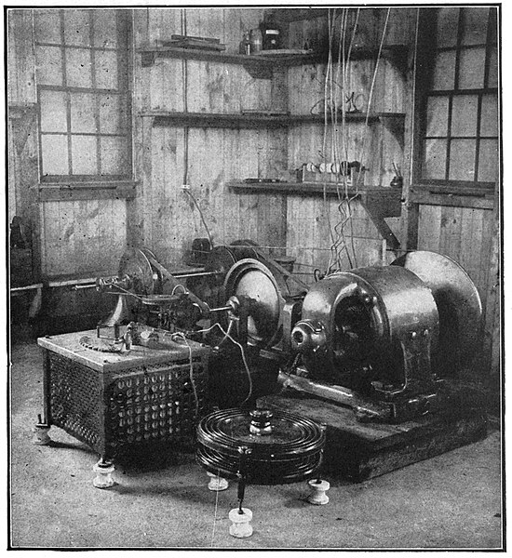
Reginald Fessenden – AM Modulation
Notes:
CLICK -Canadian born US Citizen - Worked in Radio and Sonar - Groundbreaking work in audio radio transmission CLICK
Early employment working for Edison, Westinghouse, the U.S. Weather Bureau, and the National Electric Signaling Company (NESCO) – CLICK
He and crew – Brant Rock Mass set up xmissions around Christmas Eve 1906 - CLICK
Used a high-speed electric motor (50 kHz) "alternating-current dynamo” - generated "pure sine waves" - produced "a continuous train of radiant waves “ (CW)
inserted a simple carbon microphone into the transmission line - modulated the carrier wave for AM audio transmissions - CLICK
Dec 21 1906 – Audio transmission received in Plymouth, Massachusetts (11 miles)
His controversial Christmas and New Years Eve transmissions included bible passage and Music
heard by ships at sea as far away as Norfolk, VA and the West Indies.

Slide 5
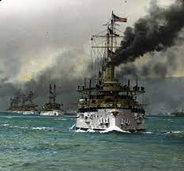
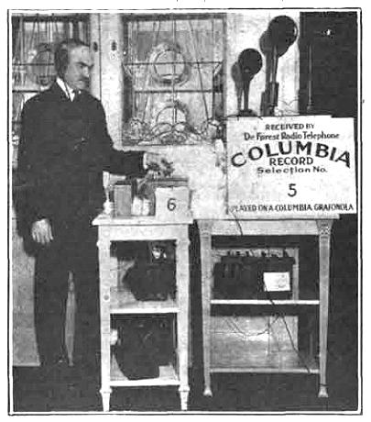
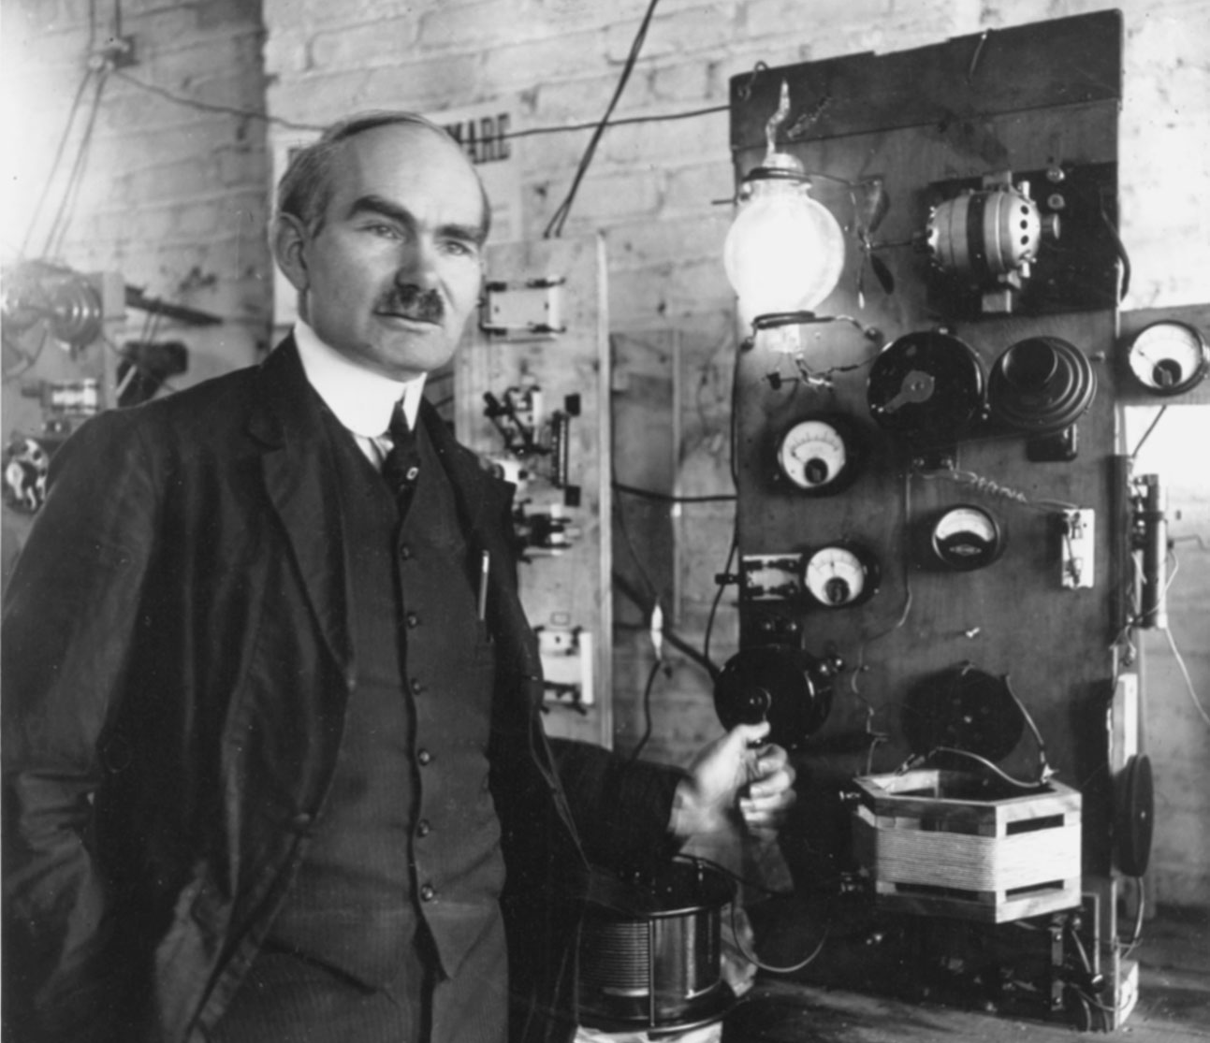
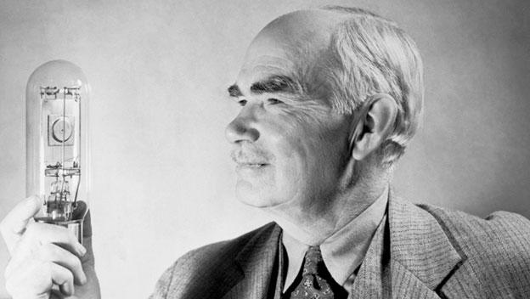
Lee de Forest – VacUum Tube
Notes:
American inventor and self-described "Father of Radio“ - CLICK
Developed the grid Audion - the first device to amplify the strength of received radio signals, and built a working arc-transmitter (both in 1906) – CLICK
Navy operators used de Forest built arc-transmitters on Great White Fleet ships to transmit voice and music – 1907-1909
arc-transmitter experimental entertainment radio broadcasts (1907-1910)
vacuum tube based transmitters, and an experimental license, de Forest resumed entertainment broadcasts (1916-1917 and 1919-1920)

Slide 6
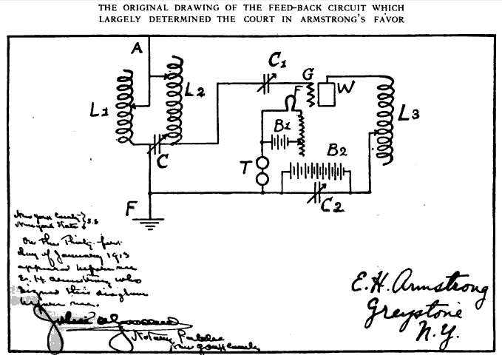
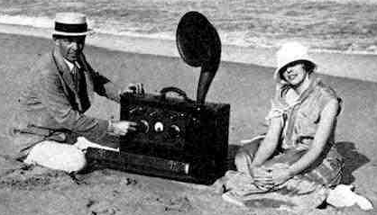
Edwin Armstrong – Tube Transmission
Notes:
American electrical engineer and inventor - developed FM (frequency modulation) radio and the superheterodyne receiver system
Discovered regeneration late in 1913 and patented it. - positive feedback ("regeneration") and oscillation, leading to tube based transmitters
Discovery was contested by Lee de Forest, who accidently discovered the same effect in 1912, but worked to eliminate it. His note book entry ended up winning him the rights in 1934.
Vacuum-tube feedback oscillators became the basis of radio transmission by 1920

Slide 7
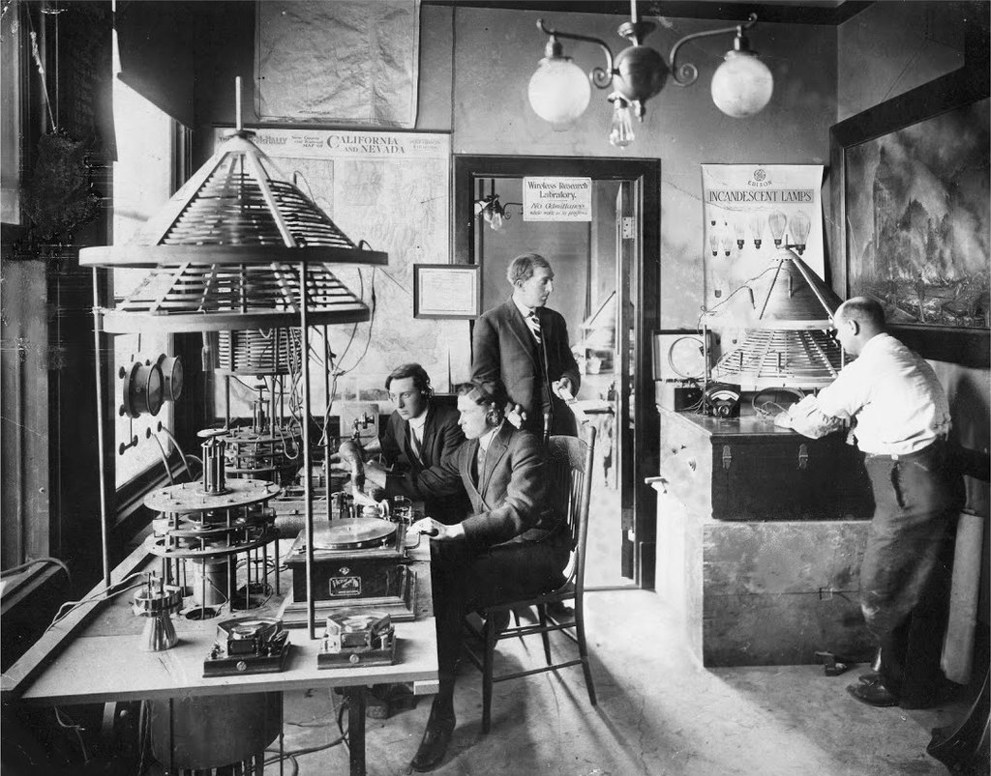
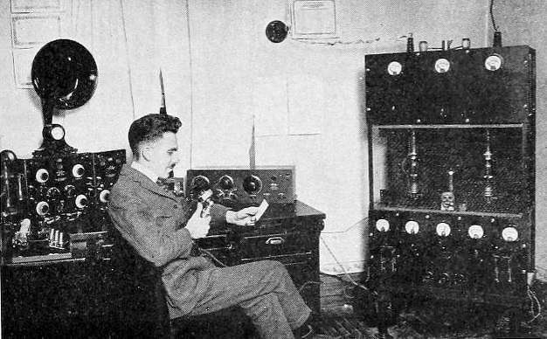
Other Early Broadcasts
Notes:
Charles Herrold –1912 Weekly broadcasts from his San Jose School For his students, ultimately with an Experimental license
Young & McCombs co-operative store, Rock Island, IL - 9BY September 1, 1920 Weekly concerts - became WOC in 1922
Dr. William Reynolds – Colorado Springs -nightly concerts - 9JE – October 1920 - became KLZ in Denver in 1922

Slide 8
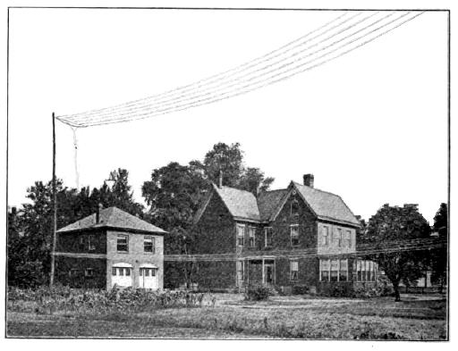
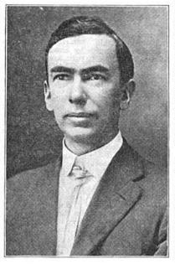
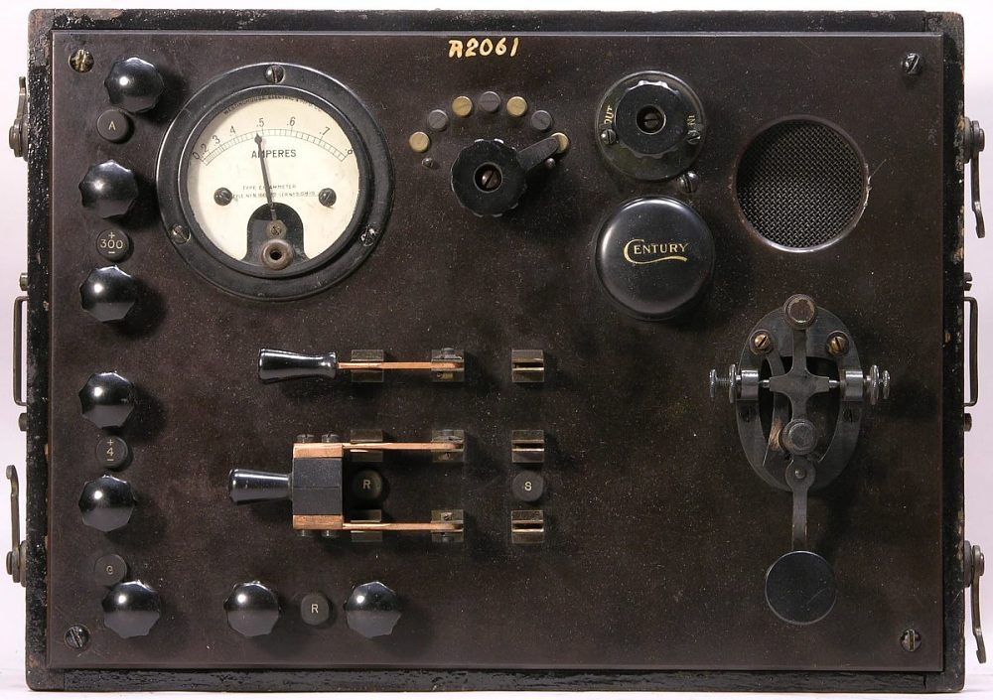
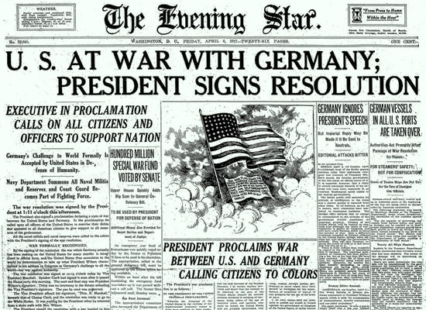
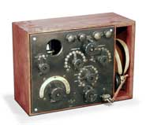
Frank Conrad – Westinghouse Engineer
Notes:
American electrical engineer - Started working for Westinghouse in 1890 at 16 -CLICK
Became interested in radio in 1913 - Built an Amateur Spark Gap Transmitter and issued an experimental license (8XK) in the summer of 1916 - CLICK
WW I - All amateur sites shut down -
Supported Westinghouse development of the tube-based SCR-69 aircraft transmitter and the SCR-70 aircraft receiver

Slide 9
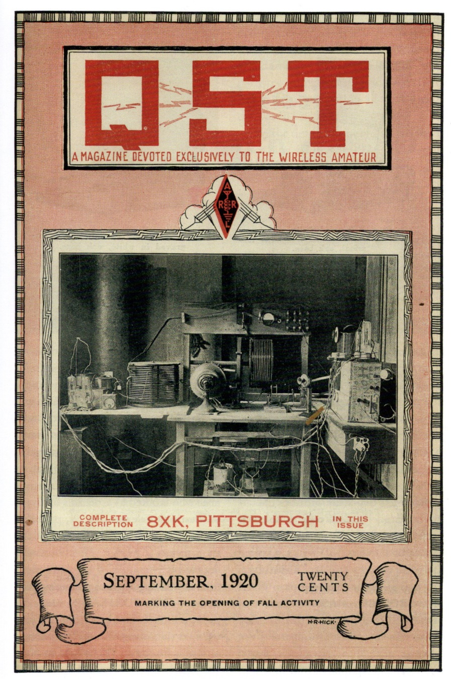
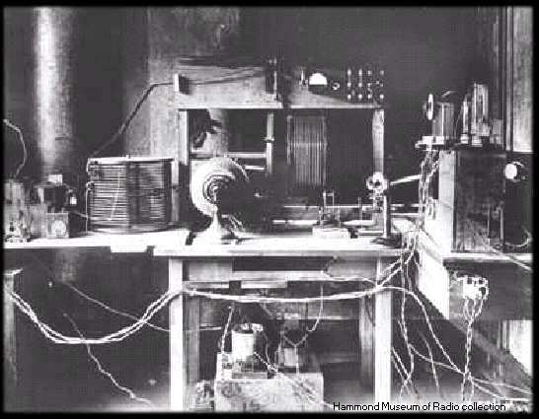
Frank Conrad After WWI
Notes:
The amateur radio ban ended on October 1, 1919
Conrad resumed operation of 8XK, broadcasting records for 2 hours Wednesday and Saturday Evenings
His station appeared in the September 1920 QST

Slide 10
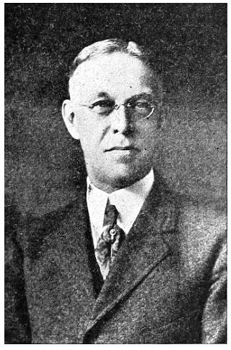
Listening Enjoyment Grows
Notes:
The popularity of Conrad’s broadcasts grew -
A Pittsburg Department store advertised his concerts and sold crystal sets
Westinghouse Vice President Harry Davis took notice
Harry P. Davis, Westinghouse vice-president, saw radio as more than “a confidential means of communication,” and realized radio “was an idea of limitless opportunity,”
Had a transmitter built on the roof of the 8 floor K building

Slide 11
The KDKA License
Notes:
Class 2 – Limited Commercial
KDKA - Issued to Westinghouse
300 to 500 Meters (600 to 1,000 KHz – Broadcast Band) - with provision for 3200 Meters (HF)
at 200 Watts
Issued on October 27th, 1920

Slide 12
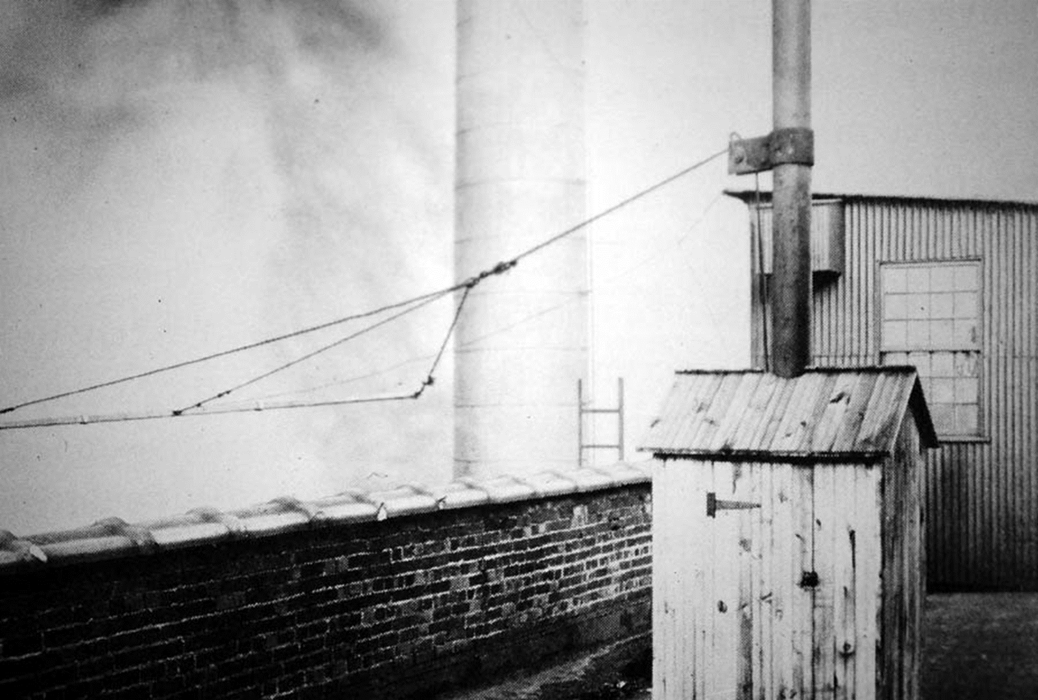
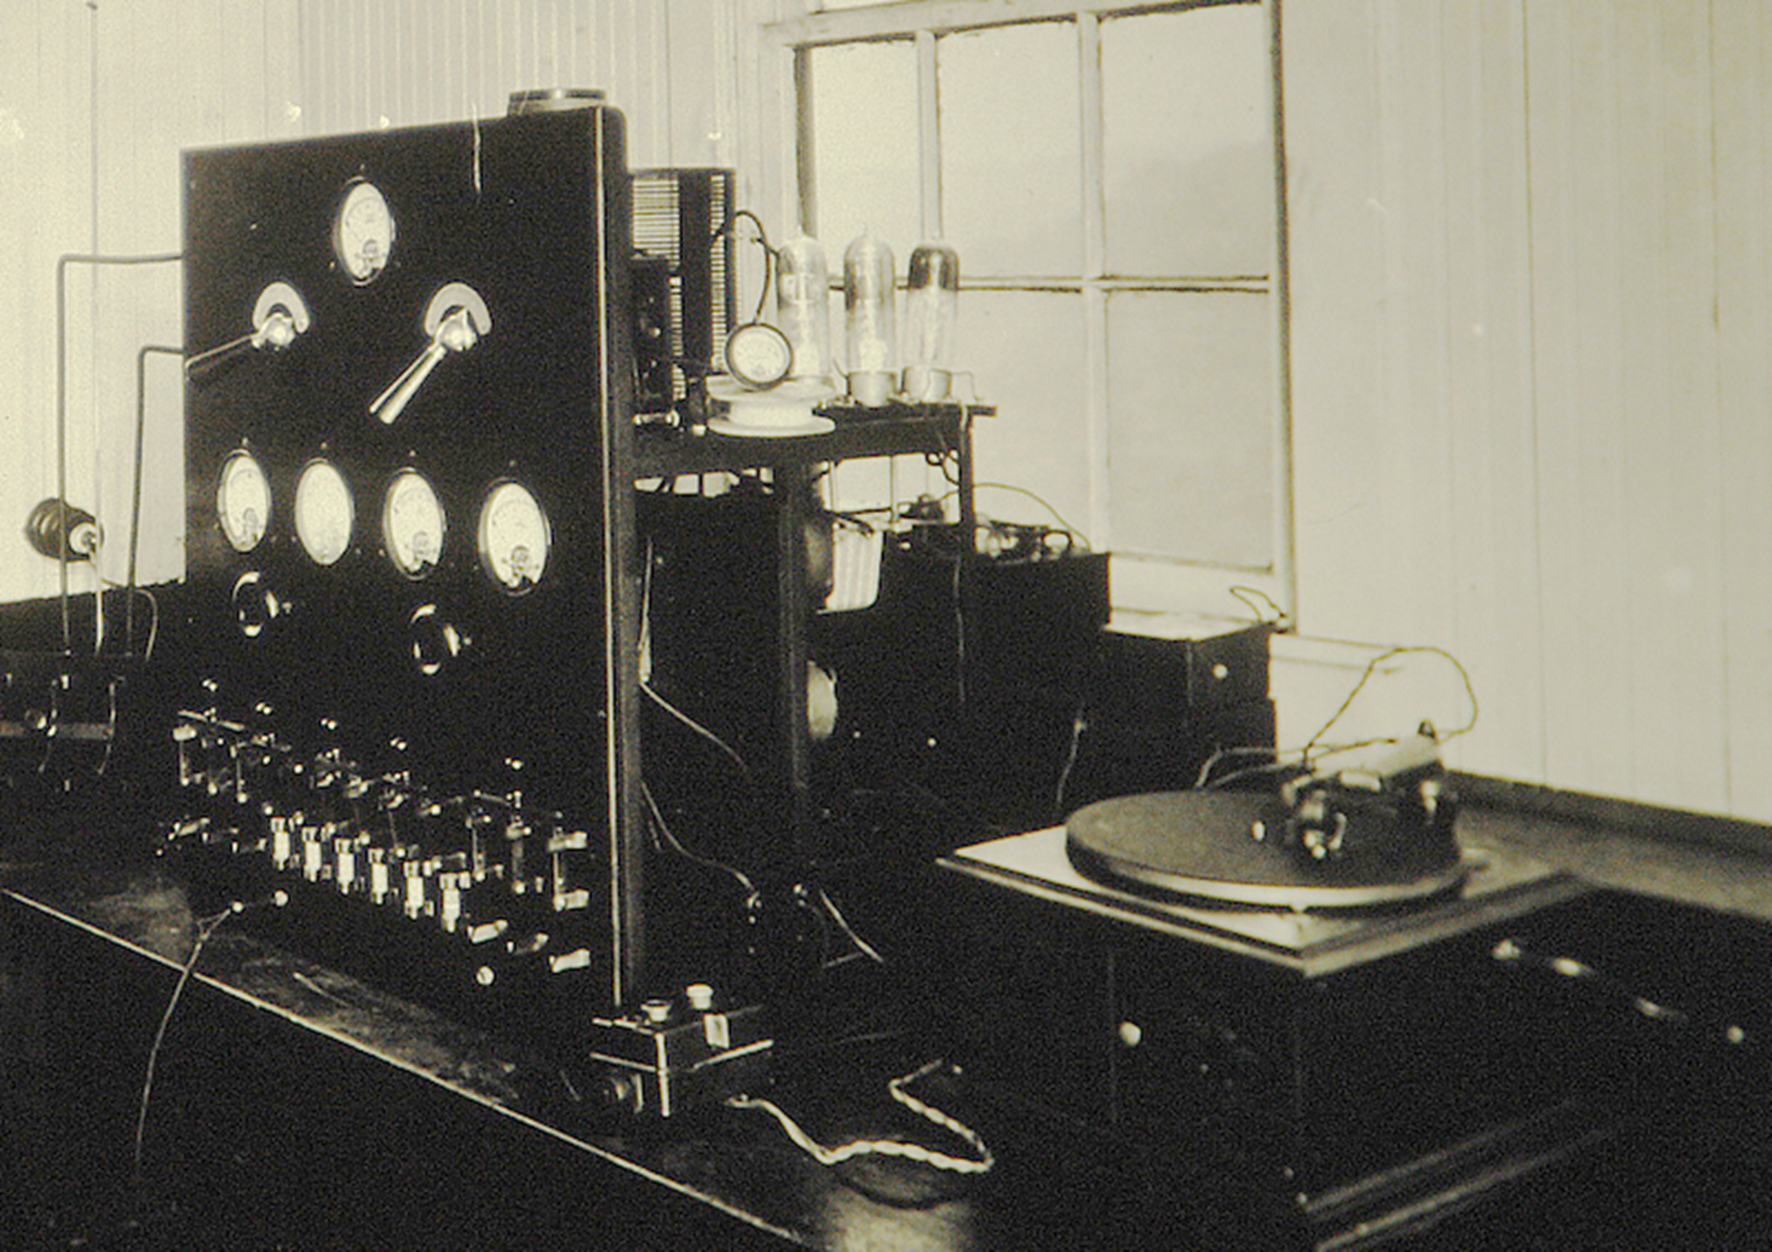
The First KDKA Transmitter
Notes:
Built in a shack on the roof
The antenna streamed between buildings
The transmitter employed 4 – 50w output vacuum tubes and a telephone mic

Slide 13
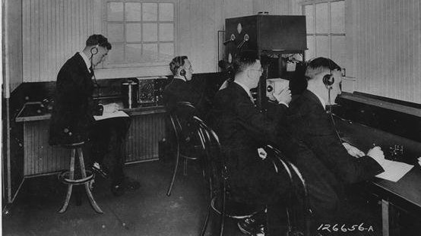
KDKA’s first broadcast
Notes:
Westinghouse launched the station as KDKA on November 2, 1920, as the first commercially licensed radio station in America, broadcasting the Harding presidential election results as its inaugural show
The initial Westinghouse broadcast crew included transmitter operator William Thomas (left), two telephone operators in communication with the news papers receiving the vote tally, R. S. McClelland (second from the left) and John Frazier (right), the announcer, speaking into the microphone (white box) was Leo H. Rosenberg. – Here is a reproduction of part of that broadcast.
The election results were relayed to about 1,000 listeners, who learned through this incredible new medium, that Warren Harding beat James Cox in the race for the Oval Office.
Radio broadcasting grew quickly.
At the beginning of 1922, there were 60 Licensed radio stations in the US
By the end of 1922, there were 573 stations, with 1.5 million operational radio receivers.
By the mid ‘20’s, there were 325 companies making radios and 60 making vacuum tubes.

Slide 14
Who was First?
The controversy over who had the first true radio broadcast will continue, but…
KDKA was the first to be broadcasting using a Class 2 – Limited Commercial License, not an Experimental or Amateur license

Slide 15
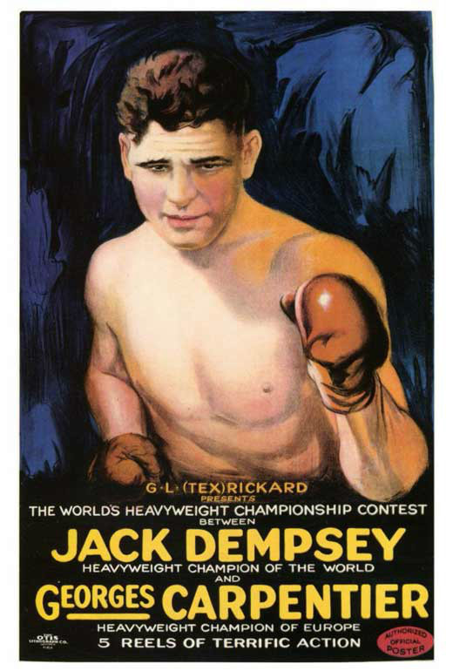
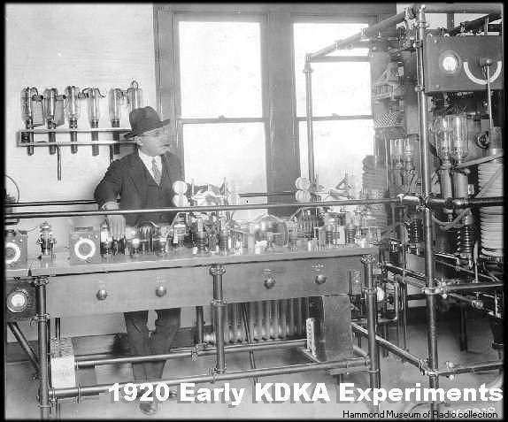
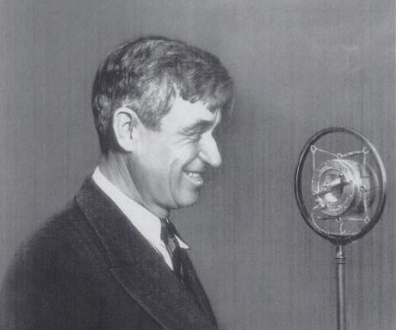
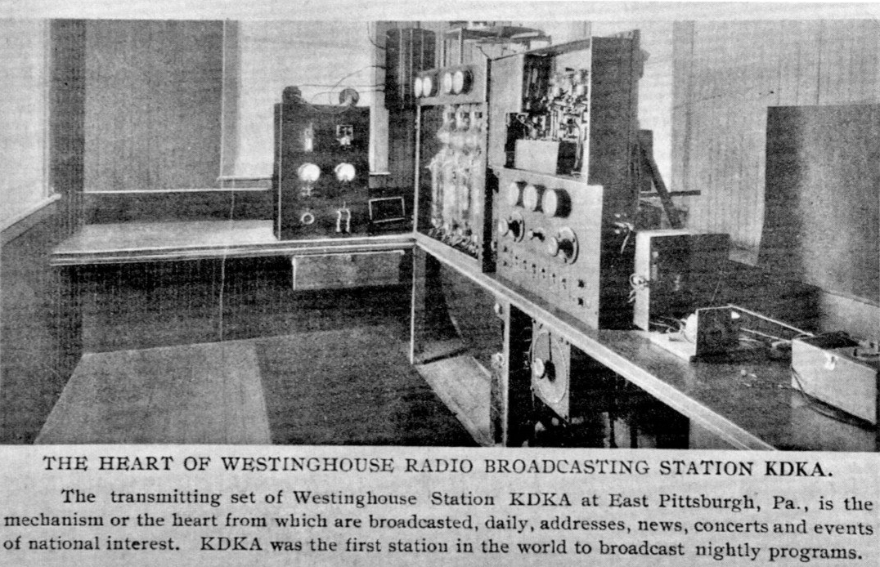
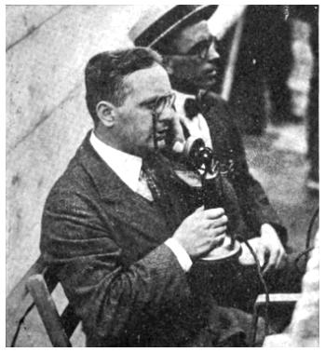
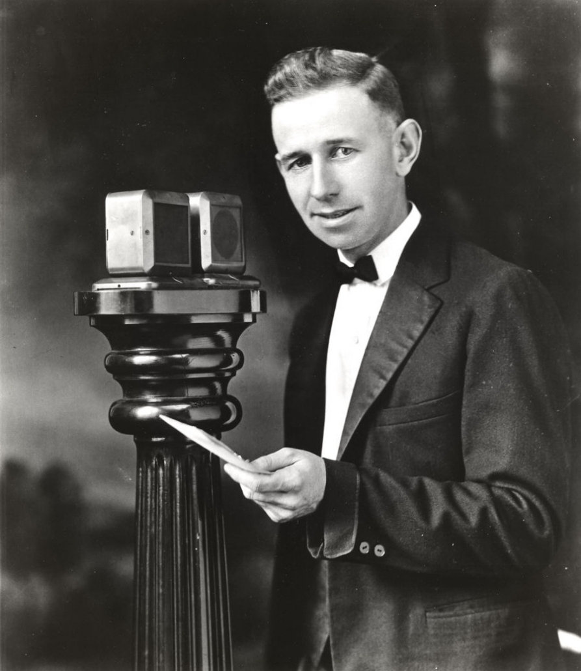
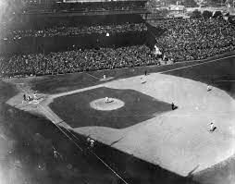
KDKA’s Immediate Growth
Notes:
Through next month semiweekly until December 21, when station started daily schedule, initially for about an hour each evening.
KDKA soon gained a reputation as one of the premier broadcasting stations in the nation. CLICK
On August 1, 1921, the transmitter was upgraded from 100 to 500 watts, and two months later saw an additional doubling, to 1,000 watts. 1922 xmitter
On July 2, 1921, RCA arranged to broadcast live, over temporary station WJY, the Jack Dempsey – Georges Carpentier heavyweight boxing match in New Jersey, with the company claiming that 300,000 persons listened to the WJY transmission. KDKA participated in the event by providing supplemental coverage west of WJY's range, as a KDKA announcer repeated the ringside commentary, after it had been relayed by telegraph by Westinghouse engineers who were listening to the WJY broadcast. KDKA's participation included six theaters where attendees were charged admission to hear the reports
On August 5, 1921, KDKA became the first radio station to broadcast a major league professional baseball game, when announcer Harold W. Arlin called the Pittsburgh Pirates-Philadelphia Phillies game from Forbes
Field In the fall of that year, the station became the first to broadcast a college football game.
In 1922, KDKA hosted political humorist Will Rogers in his first radio appearance.

Slide 16
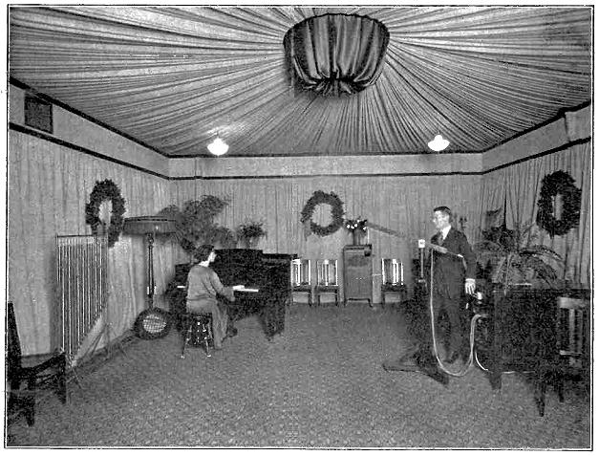
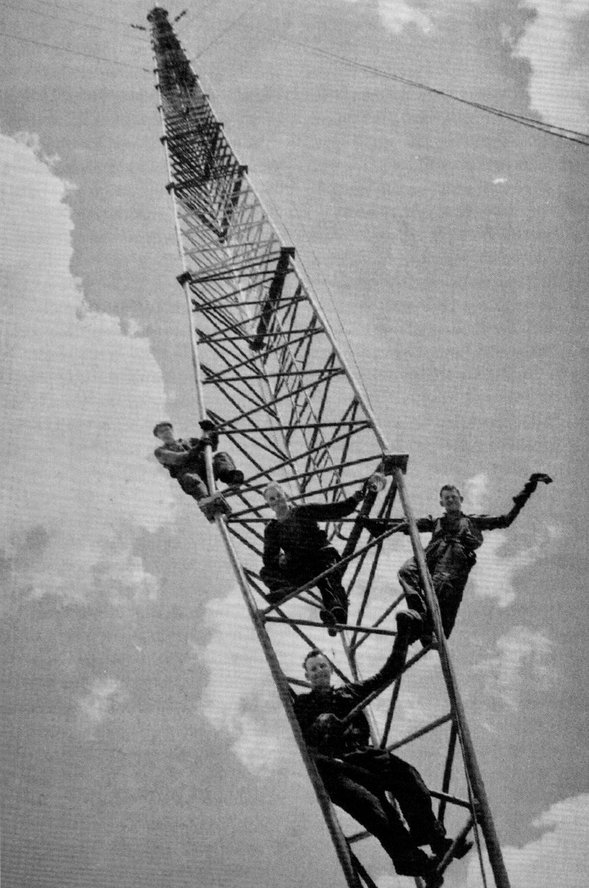
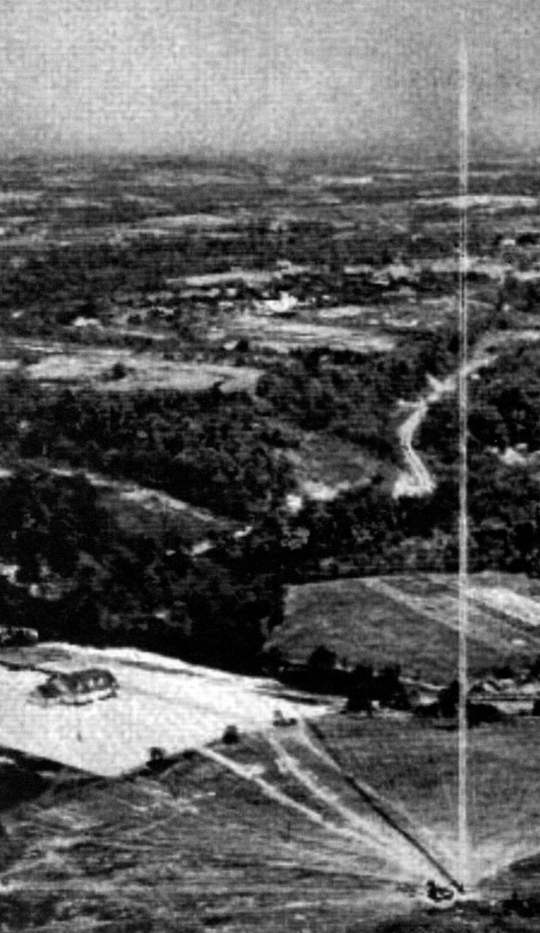
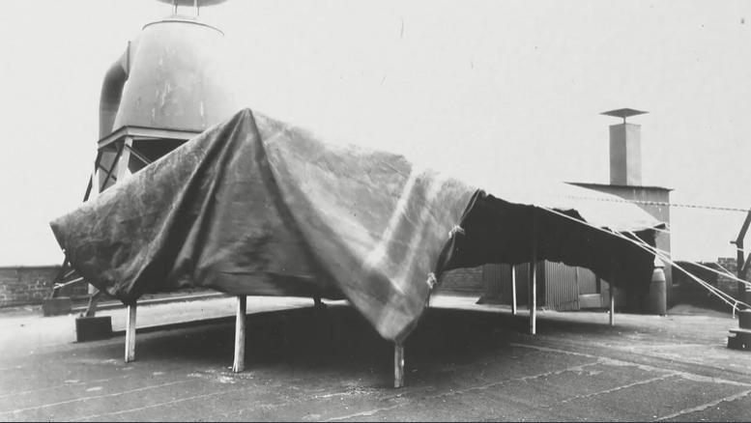
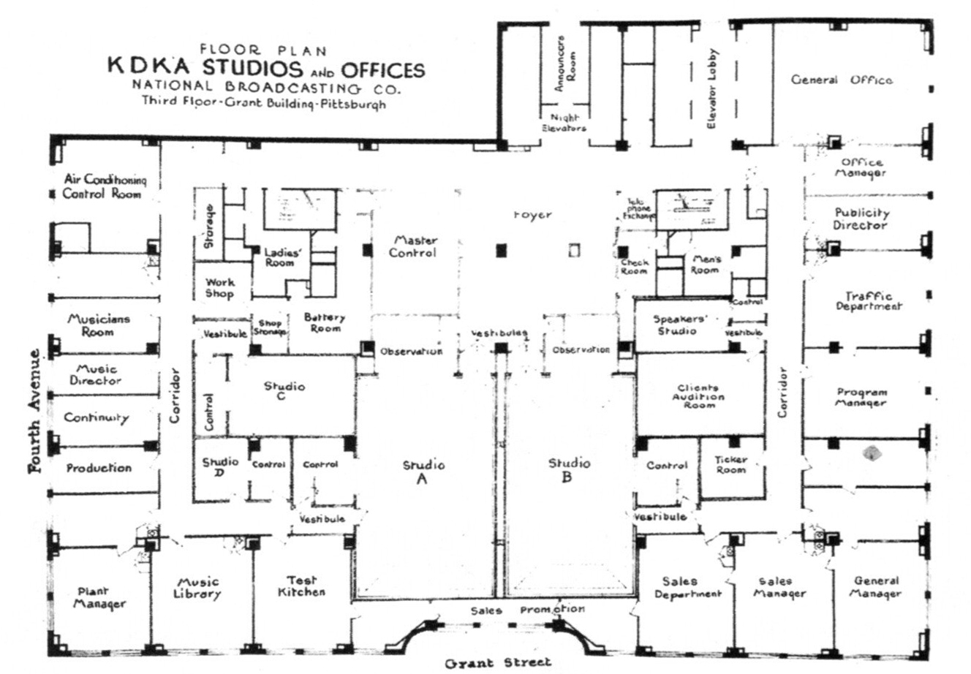
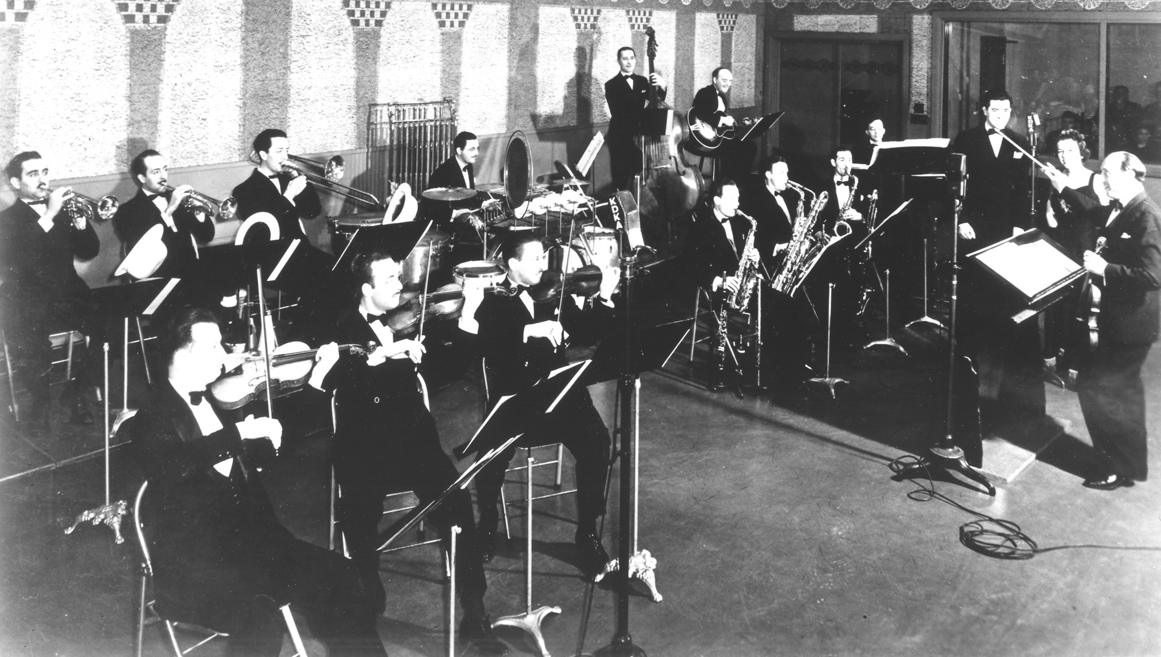
KDKA’s Early Studios
Notes:
KDKA struggled in particular with studio acoustics, especially for large groups of performers. An early attempt to broadcast a concert by Westinghouse employees from a local auditorium found that the sensitive microphones picked up echoes from the walls, causing severe distortion.
Moving the performers outdoors eliminated the echoing, so a tent was erected on the building roof, and for a time concerts were performed from this location. Eventually the tent was blown down in a storm, so it was moved indoors, where it was found the tent material helped deaden the echoes. This led to modern studio design, including walls covered with noise-absorbing material, initially "monks cloth" (which turned out to be a fancy name for burlap).
Outgrowing the K building, KDKA spent time in using studios in the old Pittsburg Post building, then two hotels, finally in 1934 on the third floor of the Pittsburg Grant building.
As its studios and transmitting power continued to grow, so did its antennas. Here is an aerial photo, and a ground photo of the 718 tower from 1938

Slide 17
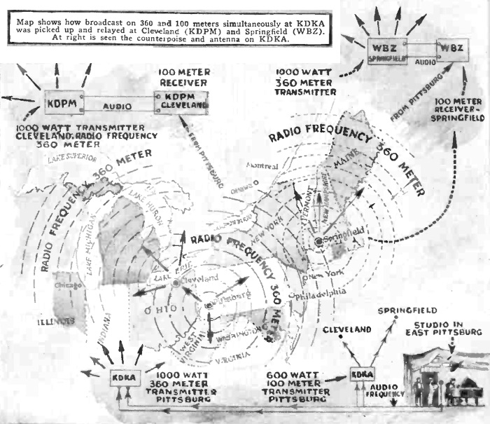
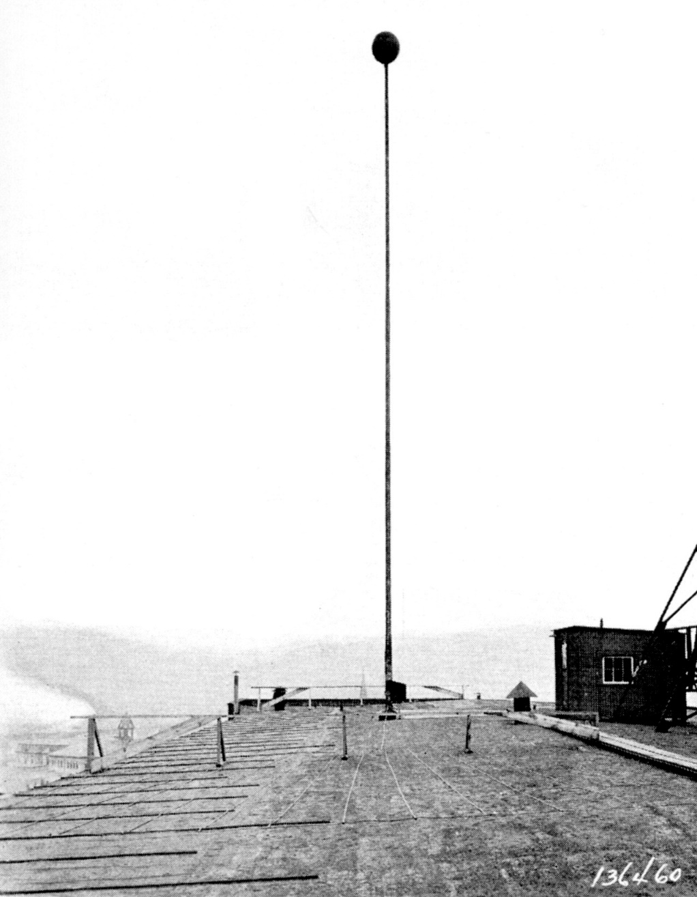
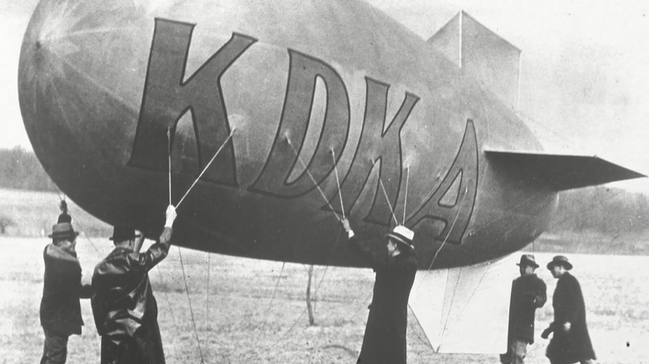
Broadcasting in the True Sense
Notes:
Encouraged by the success of KDKA, by the end of 1921 Westinghouse established stations in three additional major population centers, including WJZ in Newark, New Jersey (now WABC in New York City); WBZ, originally in Springfield, Massachusetts (now Boston); and KYW, originally in Chicago, Illinois (now Philadelphia).
In 1923, KDKA began simultaneous broadcasting on 360 Meters (830 KHz – AM Band) and 100 Meters (3 MHz – HF)
This was the Short way antenna from 1921
In 1933 – used a blimp to get a 500’ antenna 1,500 feet up

Slide 18
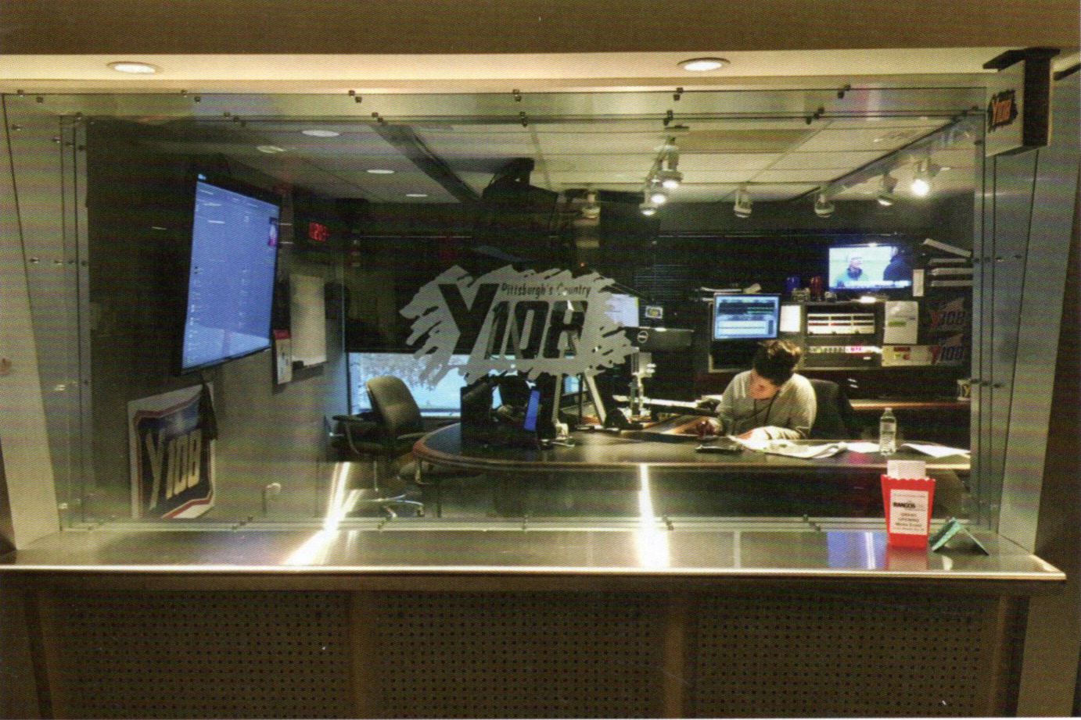
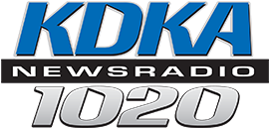
KDKA Today
Notes:
KDKA-AM is today a Class A (clear channel) radio station broadcasting on 1020 KHz
Beginning November 2, 2020, it is currently simulcast on FM translator station 100.1 MHz
It features a news/talk format, operating with a transmitter power output of 50,000 watts
Heard during daylight hours throughout central and western Pennsylvania, into nearby Ohio, West Virginia, New York, and Ontario.
Its nighttime signal covers much of eastern North America.

Slide 19
References
David and Julia Bart – Antique Wireless Review (AWR) - THE CENTENNIAL OF KDKA’S HISTORIC 1920 BROADCASTS
Brian Belanger – Dials and Channels (NCRTV) – September 2020 – A CENTURY OF ENTERTAINMENT BROADCASTING: KDKA CELEBRATES ITS 100th BIRTHDAY
Richard Brewster - Pittsburgh Antique Radio Club Presentation - THE BIRTH OF RADIO BROADCASTING
Wikipedia - Reginald Fessenden, Lee de Forest, Edwin Howard Armstrong, Charles Herrold, 9BY/WOC, 9JE/KLZ, Frank Conrad
https://www.radio.com/kdkaradio/podcasts/kdka-100-years-podcasts
http://www.thedepartmentstoremuseum.org/2010/05/joseph-horne-co-pittsburgh-pennsylvania.html
https://radio.tcapsule.com/fbis/
https://www.pabook.libraries.psu.edu/literary-cultural-heritage-map-pa/feature-articles/kdka-broadcastings-pioneer-station
https://pittsburgh.cbslocal.com/2012/03/08/kdkas-historic-broadcast/

