Slide 1

The Birth of Stereo Recording
Randy Warren, MAARC Presentation
March 21st, 2021

Slide 2
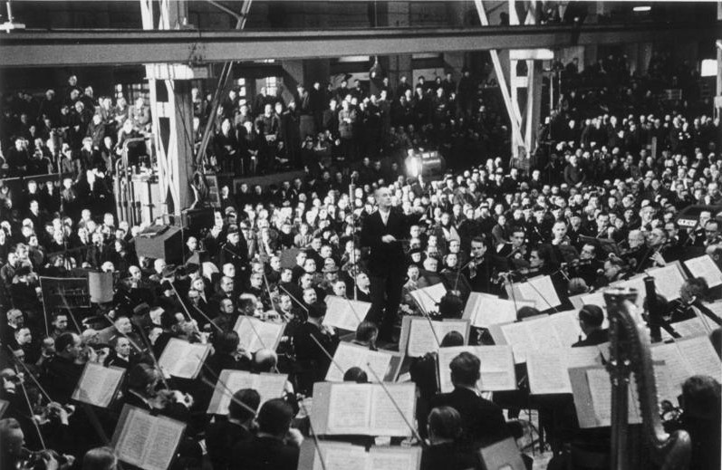
Wilhelm Furtwangler, maestro extraordinaire!

Slide 3
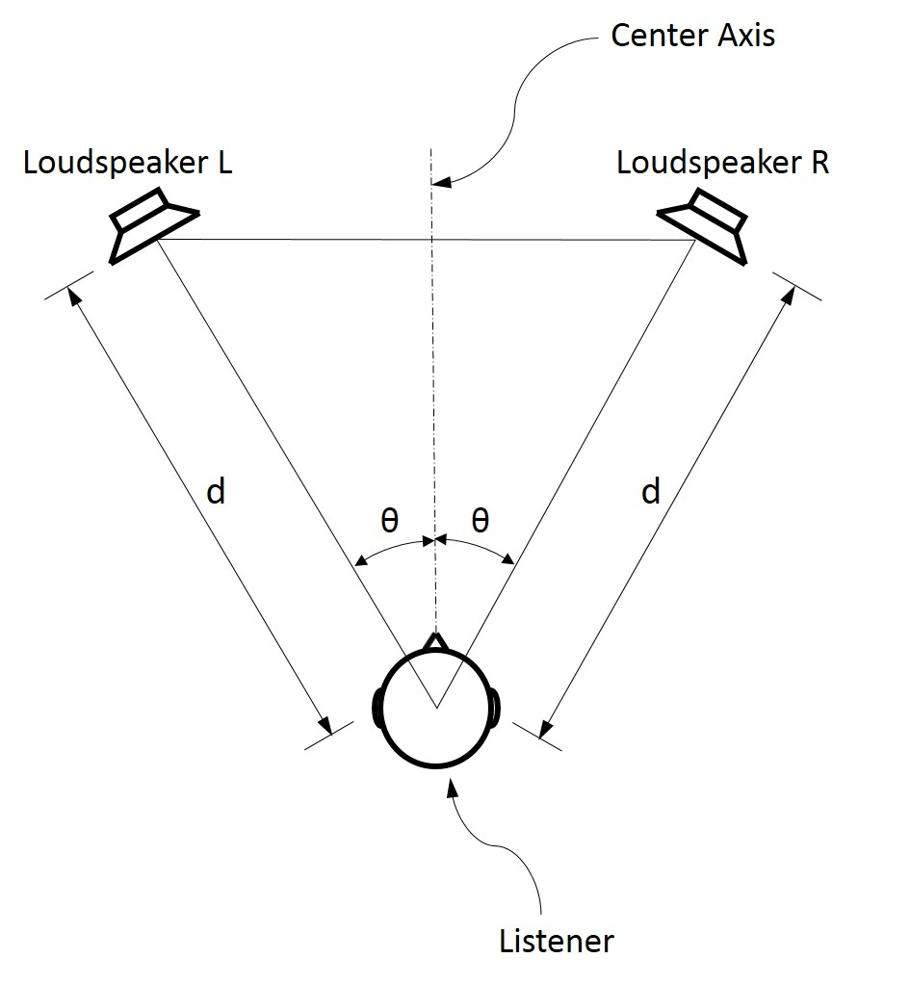
What is stereophonic sound?
“a method of sound reproduction that creates an illusion of multi-directional audible perspective.”
1) "true" or "natural" stereo in which a live sound is captured, with any natural reverberation or ambience present, by an array of microphones. The signal is then reproduced over multiple loudspeakers to recreate, as closely as possible, the live sound.
2) true stereo means sound recording and sound reproduction that uses stereographic projection to encode the relative positions of objects and events recorded.

Slide 4
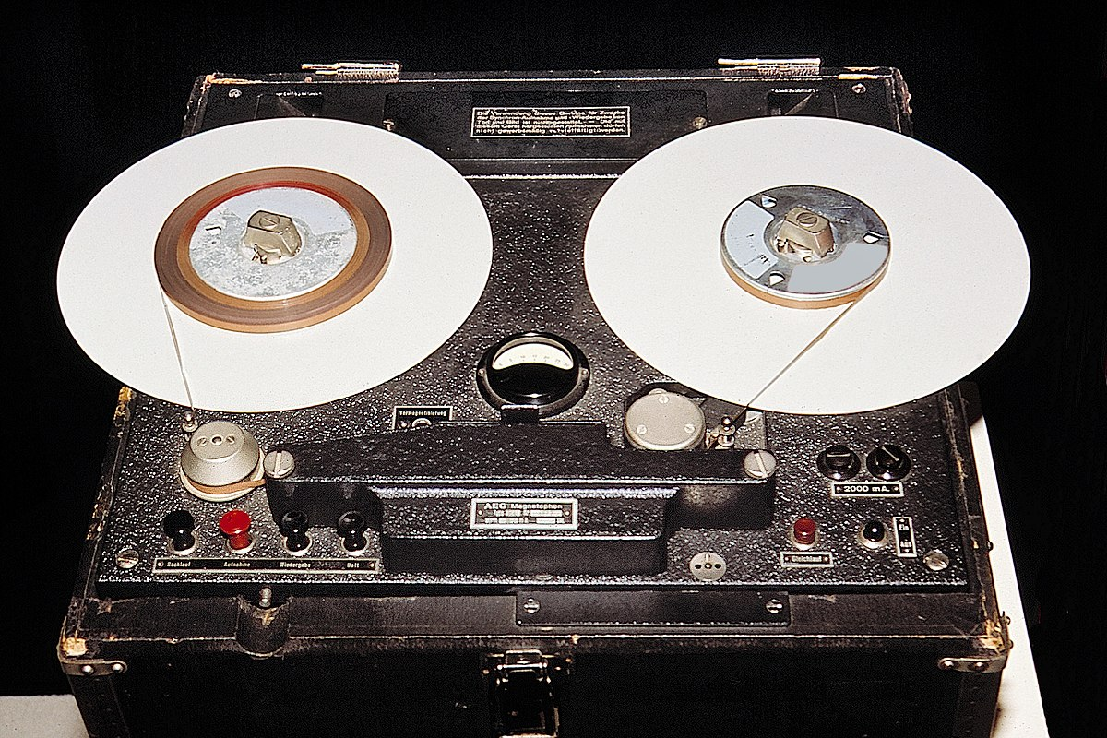
German Magnetophon Model K 4 R-player, (photo courtesy of the Museum of Magnetic recording)
A similar model was used by Helmut Kruger at the Reichs-Rundfunk-Gesellschaft, RRG (German Broadcasting Corporation) facilities at the Haus des Rundfunks (HdR) where many of the wartime recordings were made. When recording in stereo, three Neumann condenser mics were arrayed across the front of the orchestra above the conductor. This same pattern was used by both Mercury and RCA in their early stereo recordings

Slide 5
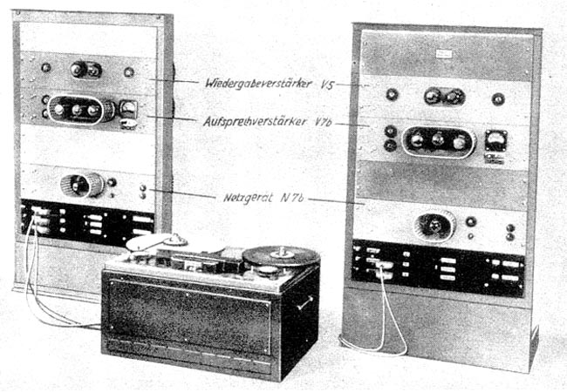
AEG K7 RRG modified stereo recorder. The use of synchronous motors helped to make outstanding stereo and mono recordings of primarily classical material. It is estimated that 250-300 tape recordings were made in stereo by the RRG during the war years.

Slide 6
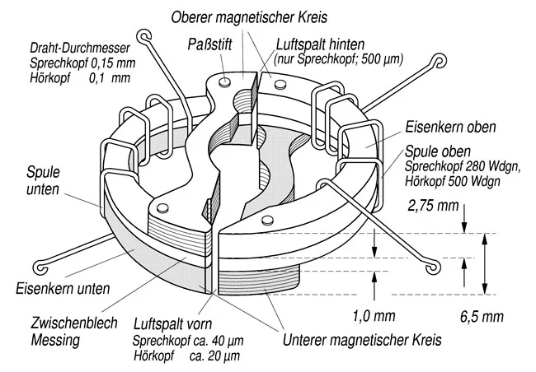
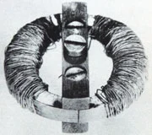
Eduard Schuller’s ring head: the combination of head gap size and tape speed determines the high frequency recording capability.

Slide 7
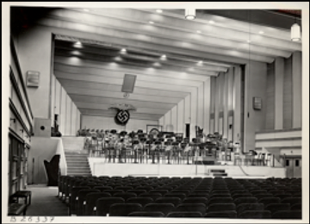
Haus des Rundfunks, Saal 1, circa 1938

Slide 8
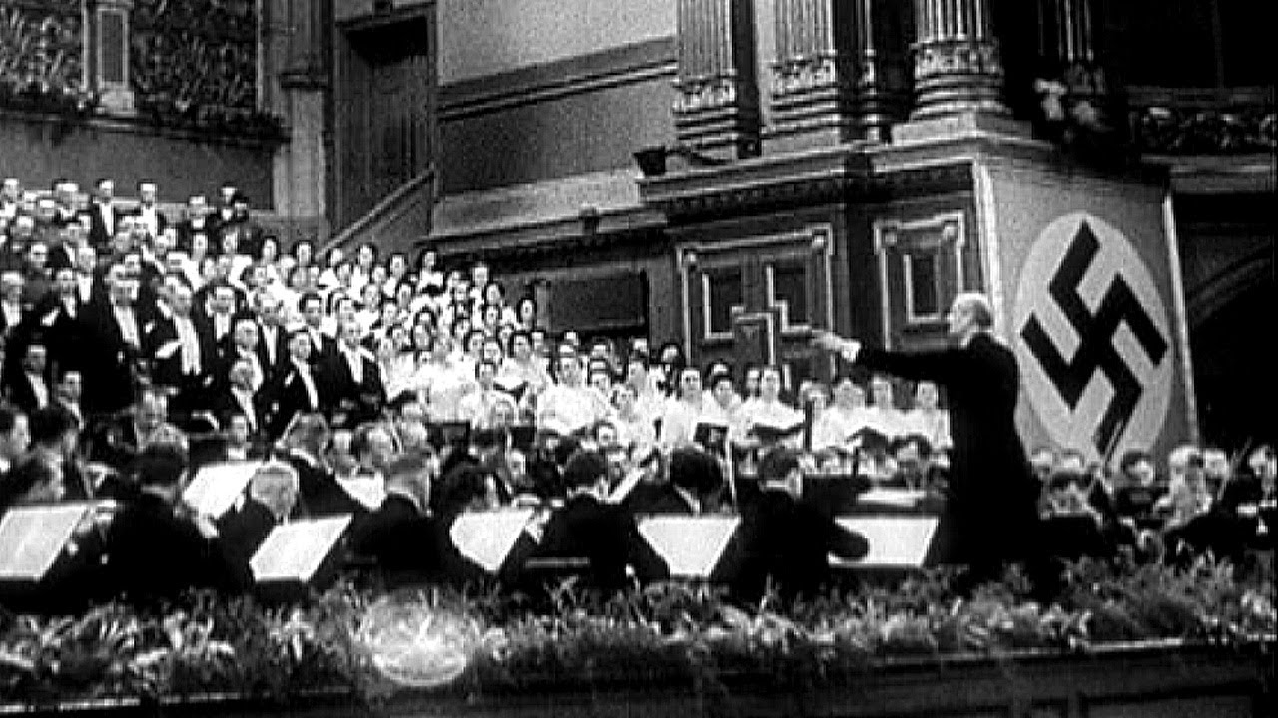
On April 6th, 1943, the first stereo recording on tape was made of the rondo of the 1st orchestral serenade, op. 11 of Johannes Brahms with the Berlin Radio Orchestra

Slide 9


Slide 10
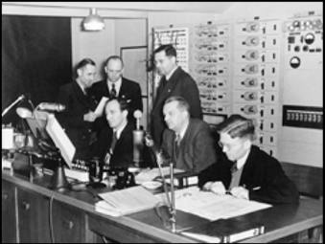
Helmut Kruger, far left, and associates. Kruger was assigned to perform the stereo experiments, in effect he was “bootlegging” stereo recordings into his recorder while the regular mono recorders were recording the performances at the same time!

Slide 11
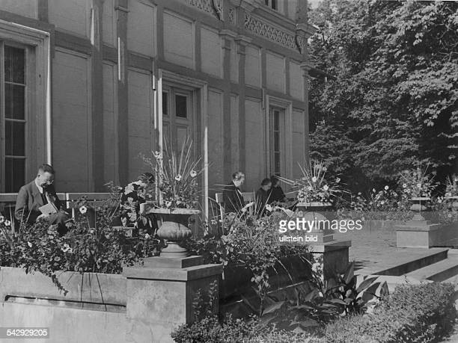
With the bombing of Berlin increasing, RRG moved their stereo recordings to the Kosten spa, which had a dark past. Previously, the SS had taken over the psychiatric hospital there and murdered 600 patients and civilians. With new AEG facilities there, Dr. von Braunmuhl hosted stereo listening sessions for the staff, doctors, convalescing soldiers, and the general public. A report noted that:
“In order to recreate the full breadth of playback, two channels, which are the result of a few spaced microphones, are played back using two separated loudspeakers. It’s an unqualified success: any disturbing background noise, which especially troubles a phonograph recording of a piano, is suddenly gone. Also, subtle orchestral parts come through with transparency and form, so that one has the complete illusion of the separation of the instruments in the room. An even stronger impression comes from the playback of the human voice.”
Kosten Spa, 1939

Slide 12
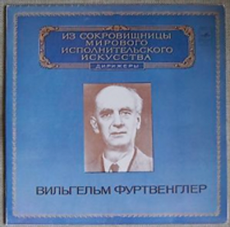
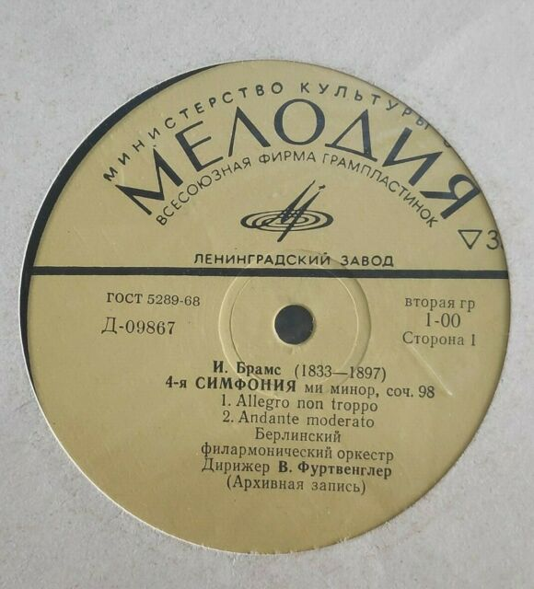
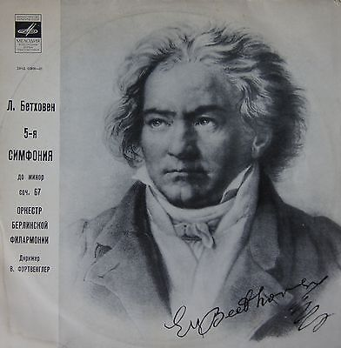
After the fall of Berlin, the Soviets removed all of the tape held at the RRG archive and moved them to Moscow. Some of these tapes found a second life on the USSR Melodiya label, these recordings released in the 1960s. Later, a large cache was repatriated back to Germany in 1993, however only 5 of the more than 250 stereo recordings have been found to date.

Slide 13
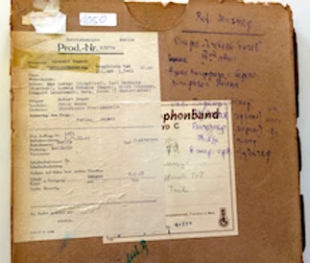
Tape and box of German WWII recording of the third act of “Gotterdamerung” by the Berlin Staatskapell conducted by Robert Heger in November 1944. This tape had been edited for broadcast in April 1945, one month before the Soviets were to take over the HdR.

Slide 14
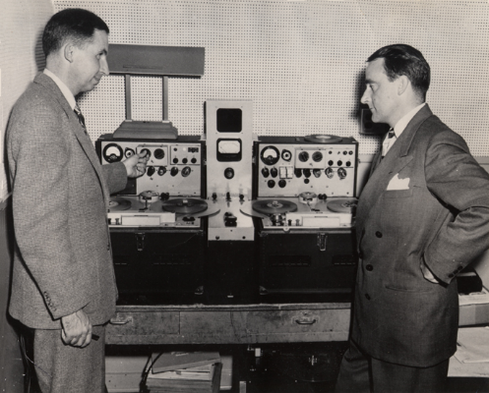
A par of “liberated” Magnetophons, model K 4. Jack Mullins, who helped to bring the German tape recording technology to the US, is to the left.

Slide 15
In short, everything we listen to today owes a debt to the Magnetophon.

Slide 16
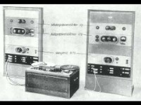
Excerpt of 1944 stereo tape recording with Bruckner Berliner Staatsoper and Herbert von Karajan (8th Symphony)

Slide 17
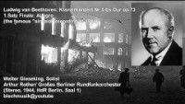
Note: bombing sounds around 2’30”+ and anti-aircraft sounds around 5’44”+

Slide 18
References
1) https://en.wikipedia.org/wiki/Stereophonic_sound
2) Museum of Magnetic Recording
3) Mountain, Toby, “The Birth of Stereo Recording”
4) https://www.theregister.com/Print/2013/09/09/history_of_magnetic_tape_part_one/
5) A History of audio engineering and magnetic recording before 1943, The AES 94th convention report, Audio Engineering Society 1993,

